Slide 1
Working together in Earley
Jules Shaw – Land Management Surveyor
Molli Cleaver – Community Engagement Manager

Slide 2
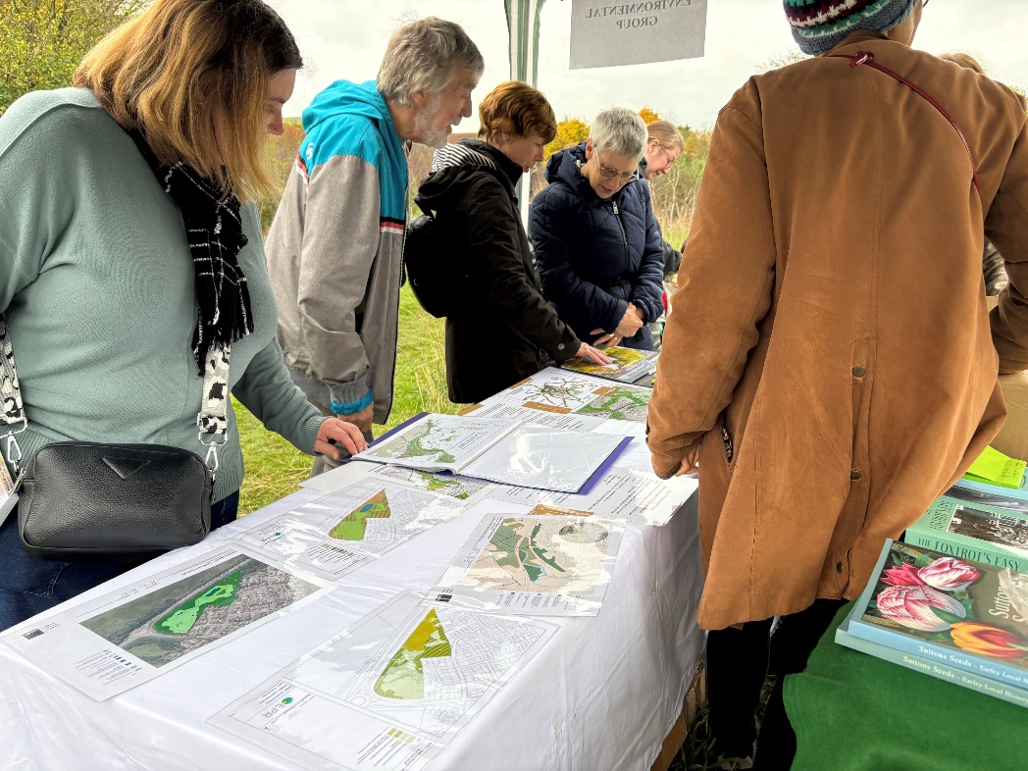
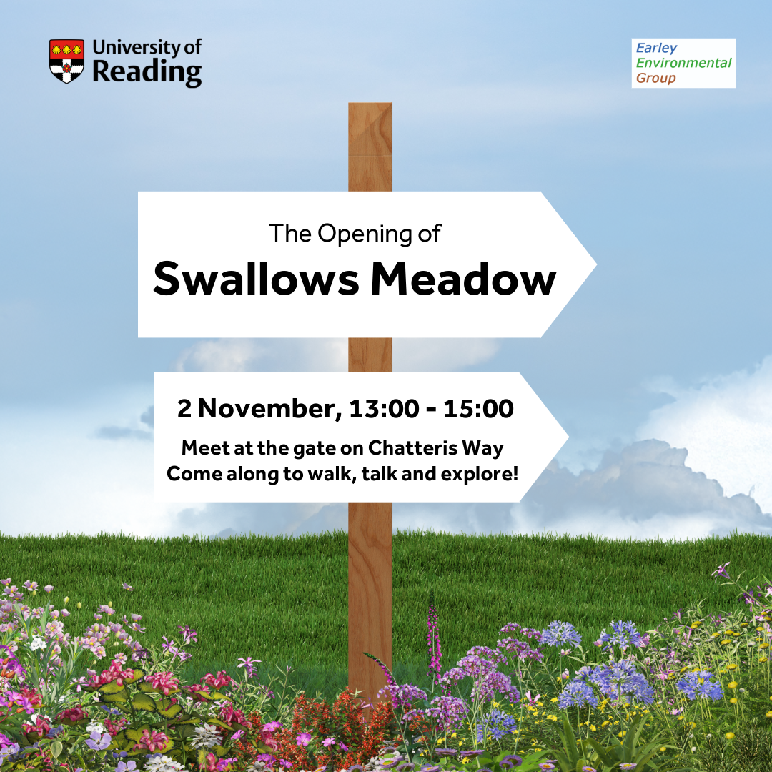
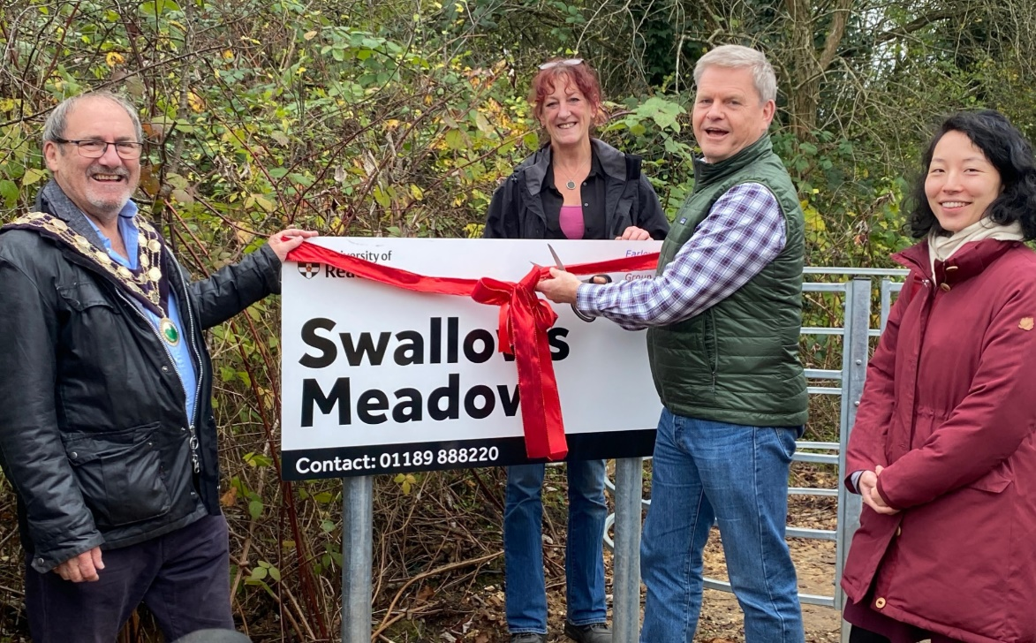

Slide 3
