Slide 2
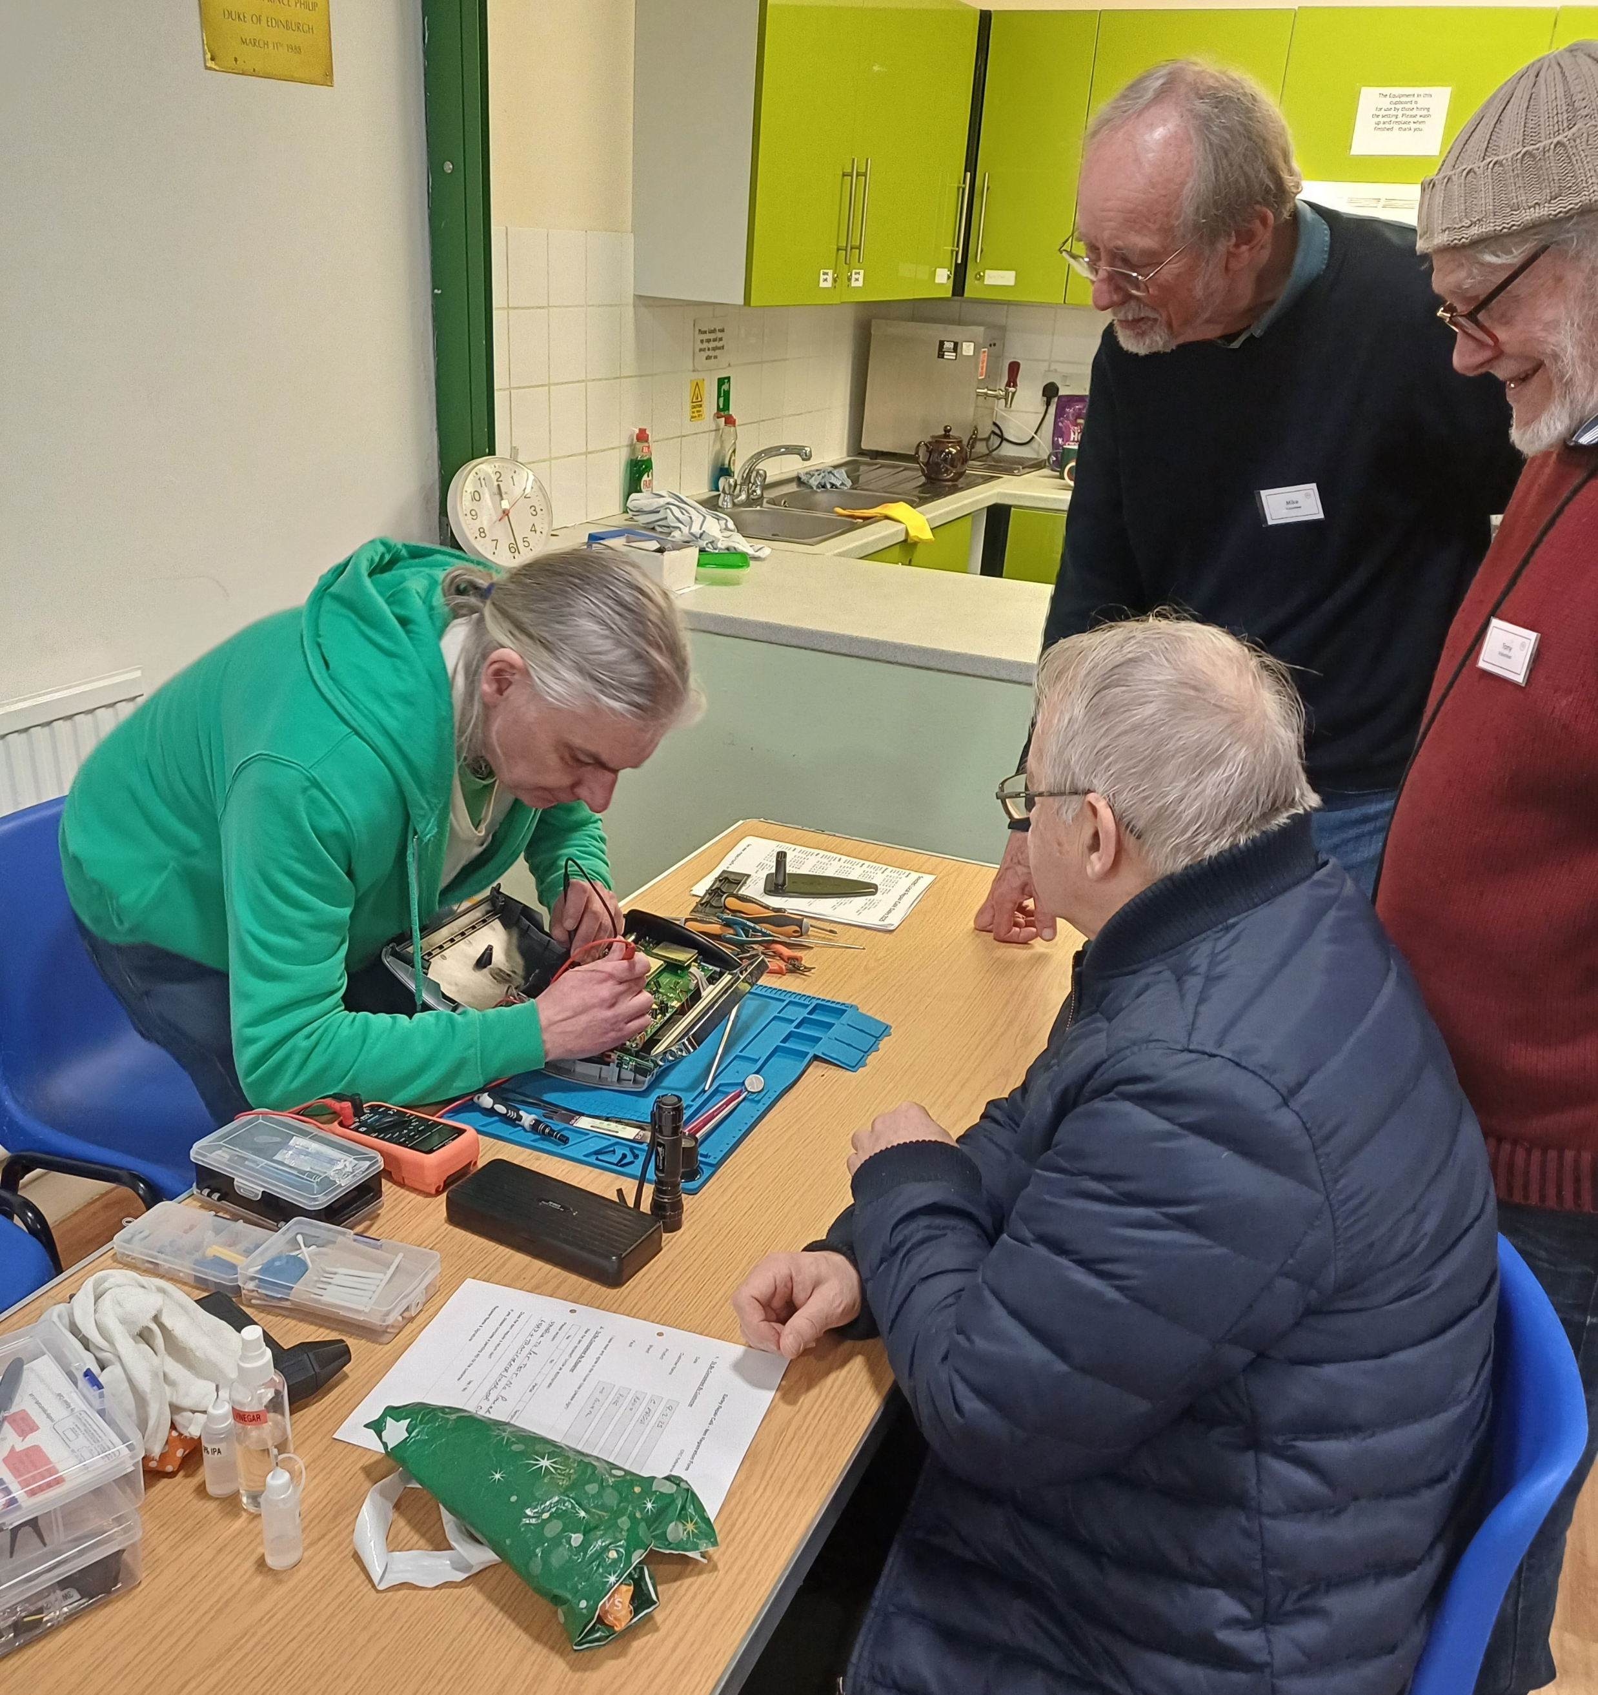
A Bit of Background
Over 2,500 Repair Cafés worldwide
Aims
to reduce landfill
tackle “throw away” culture
pass on valuable skills
Donation based

Slide 3
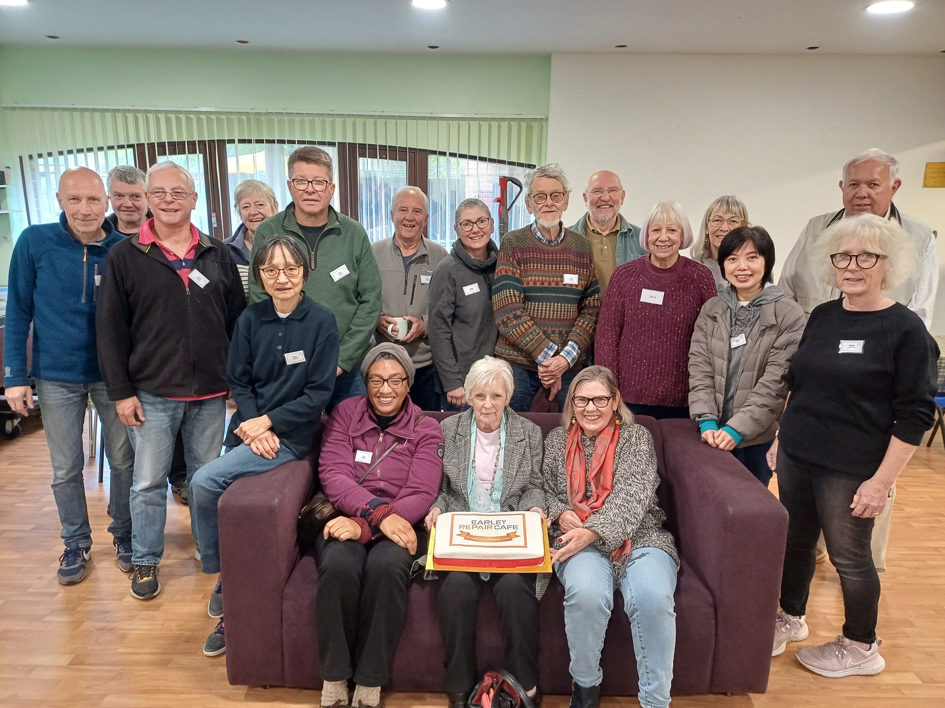
The Earley Repair Café opened its doors on Sunday 13th October 2024

Slide 4
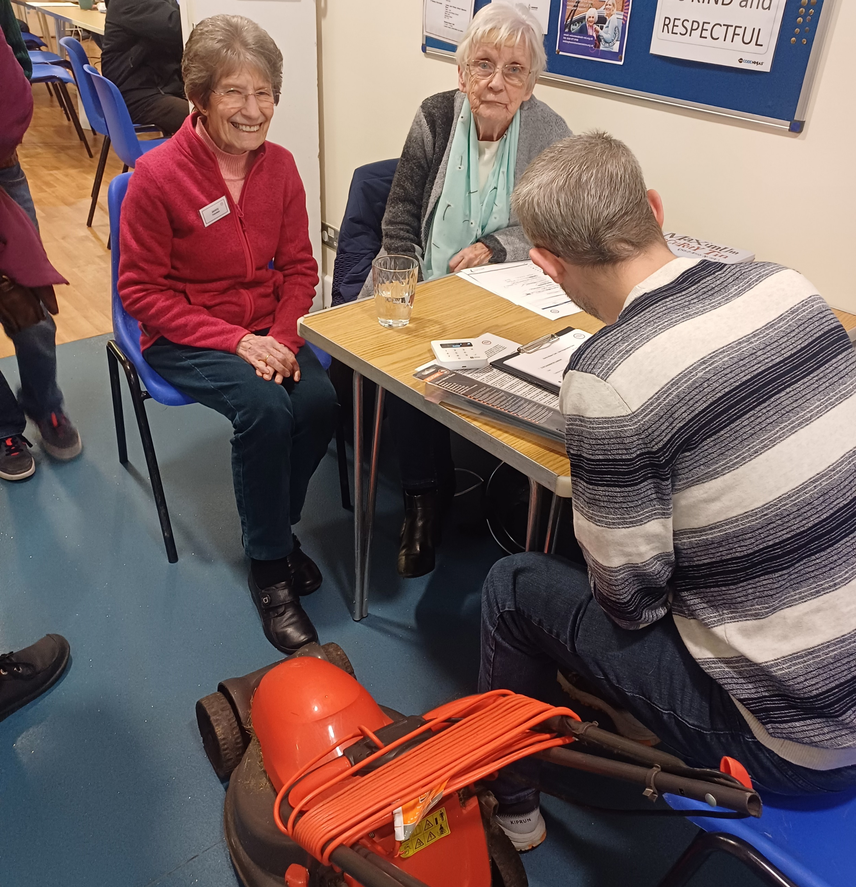
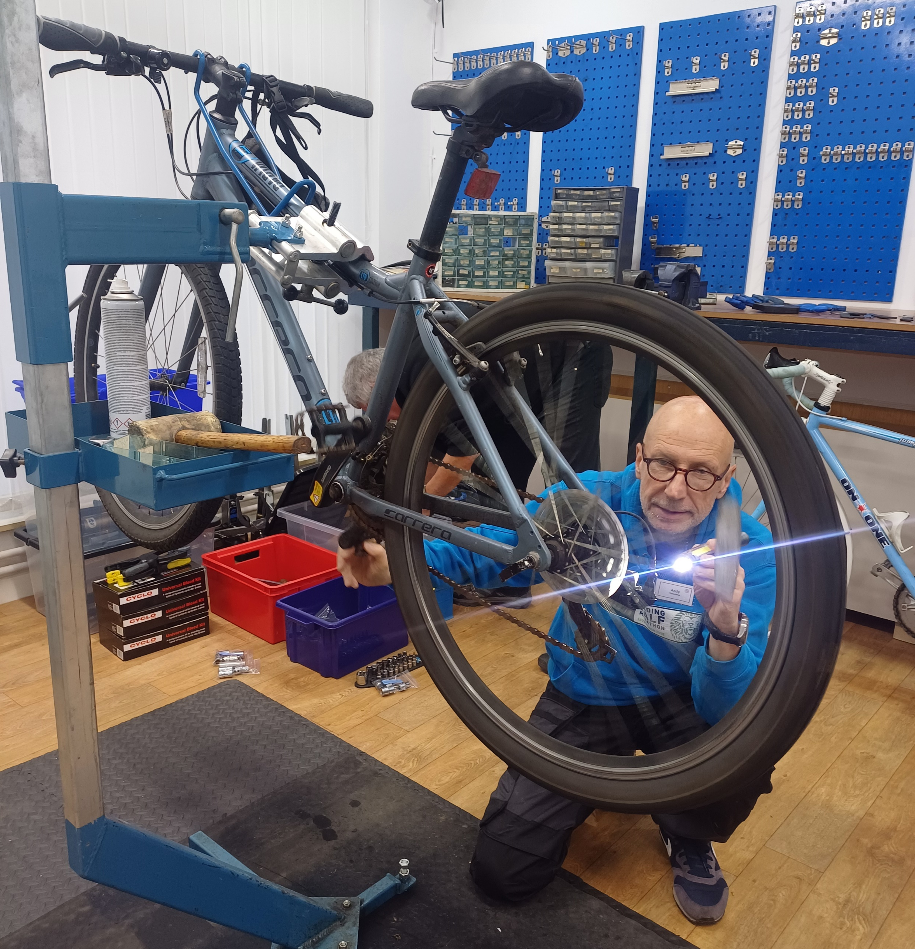
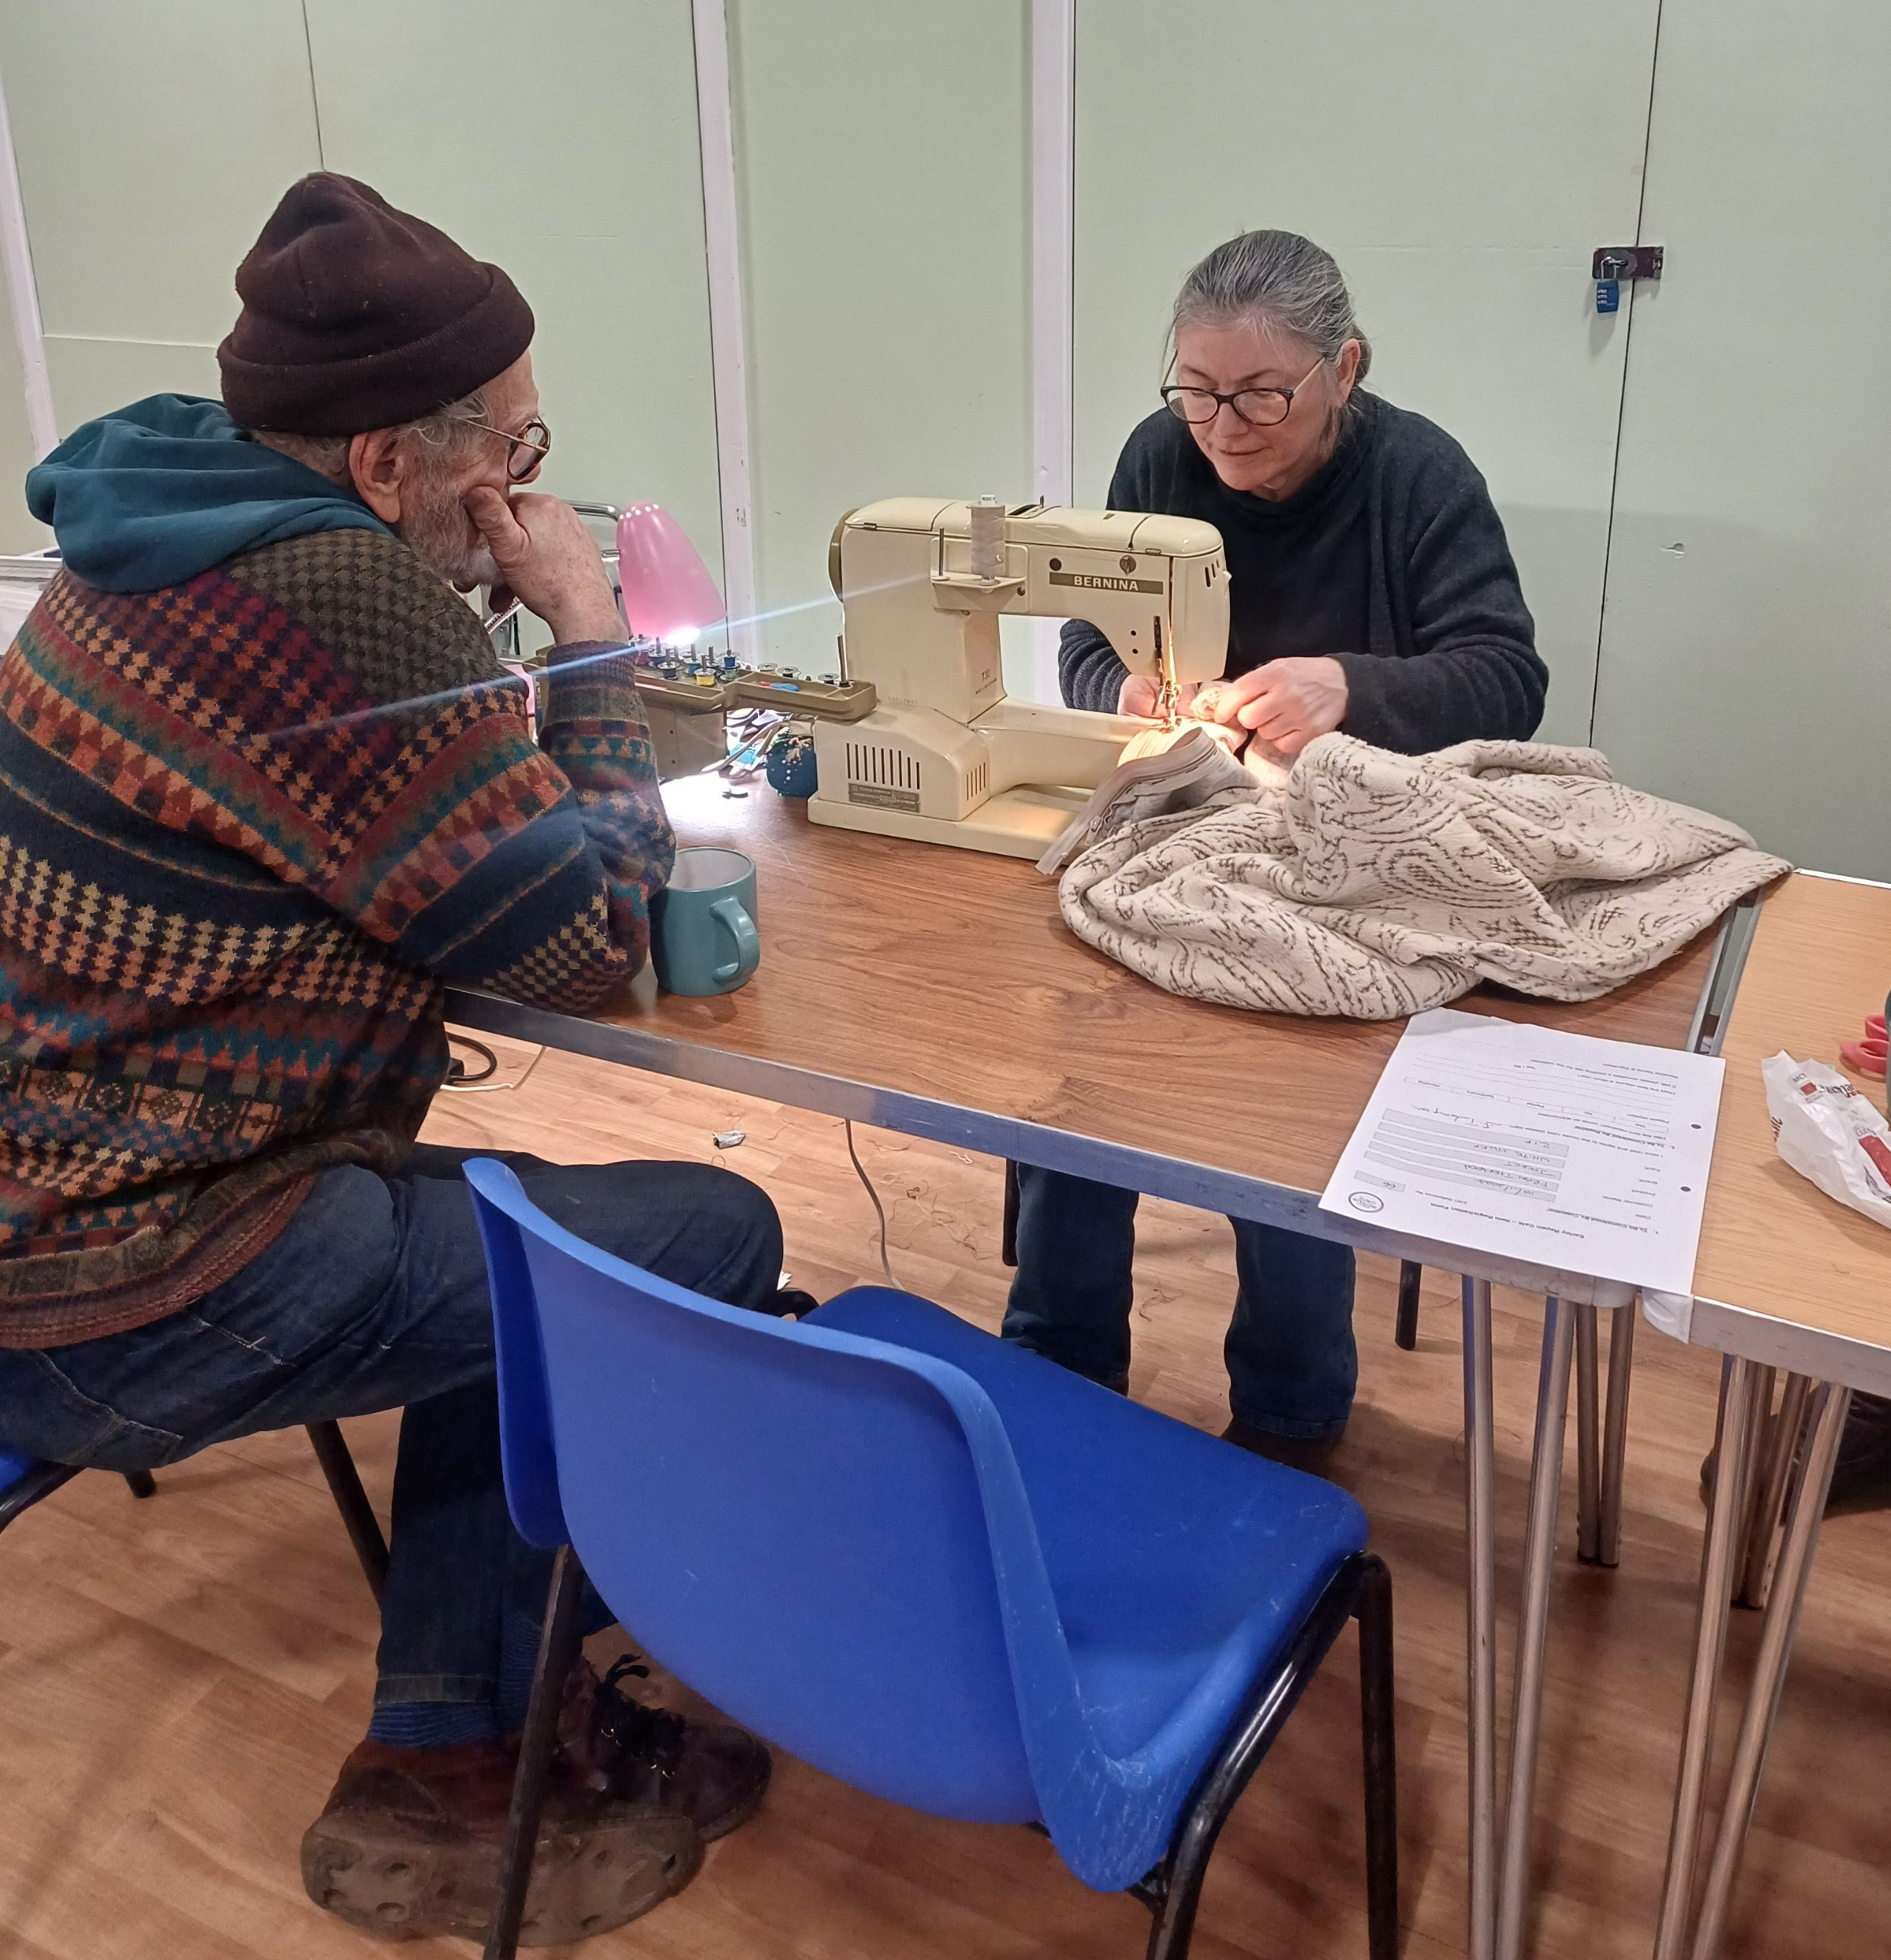
When and where is the Earley Repair Café?
Second Sunday of the month
10am – 1pm
Centrepoint Community Centre

Slide 5
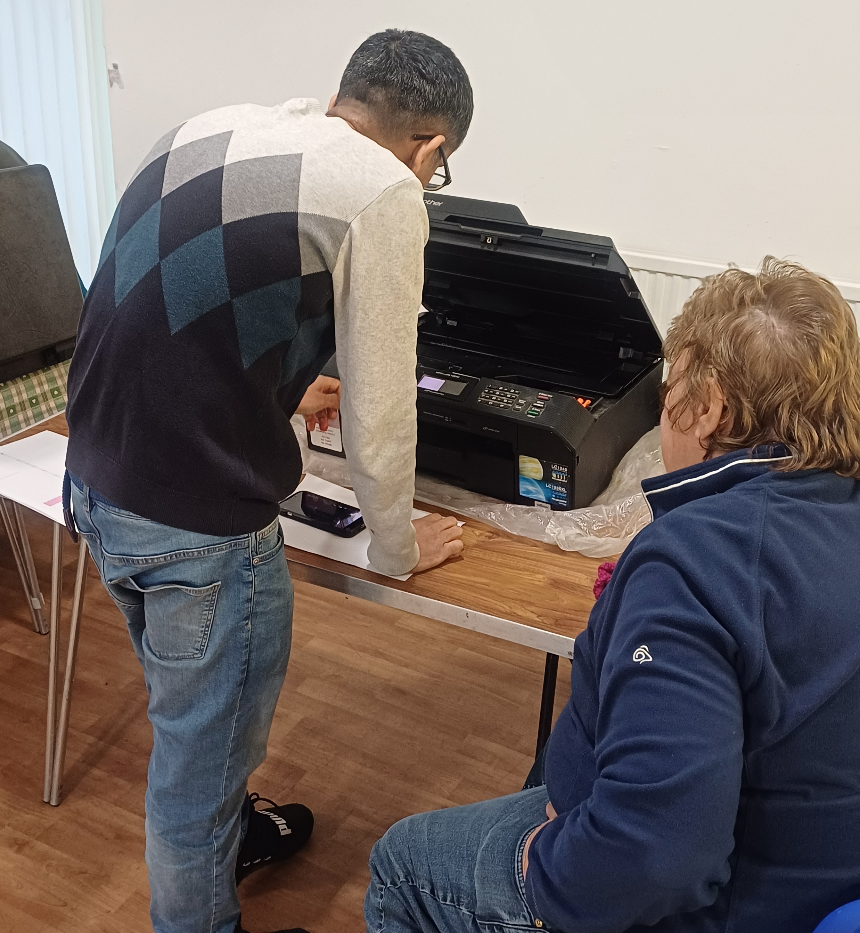
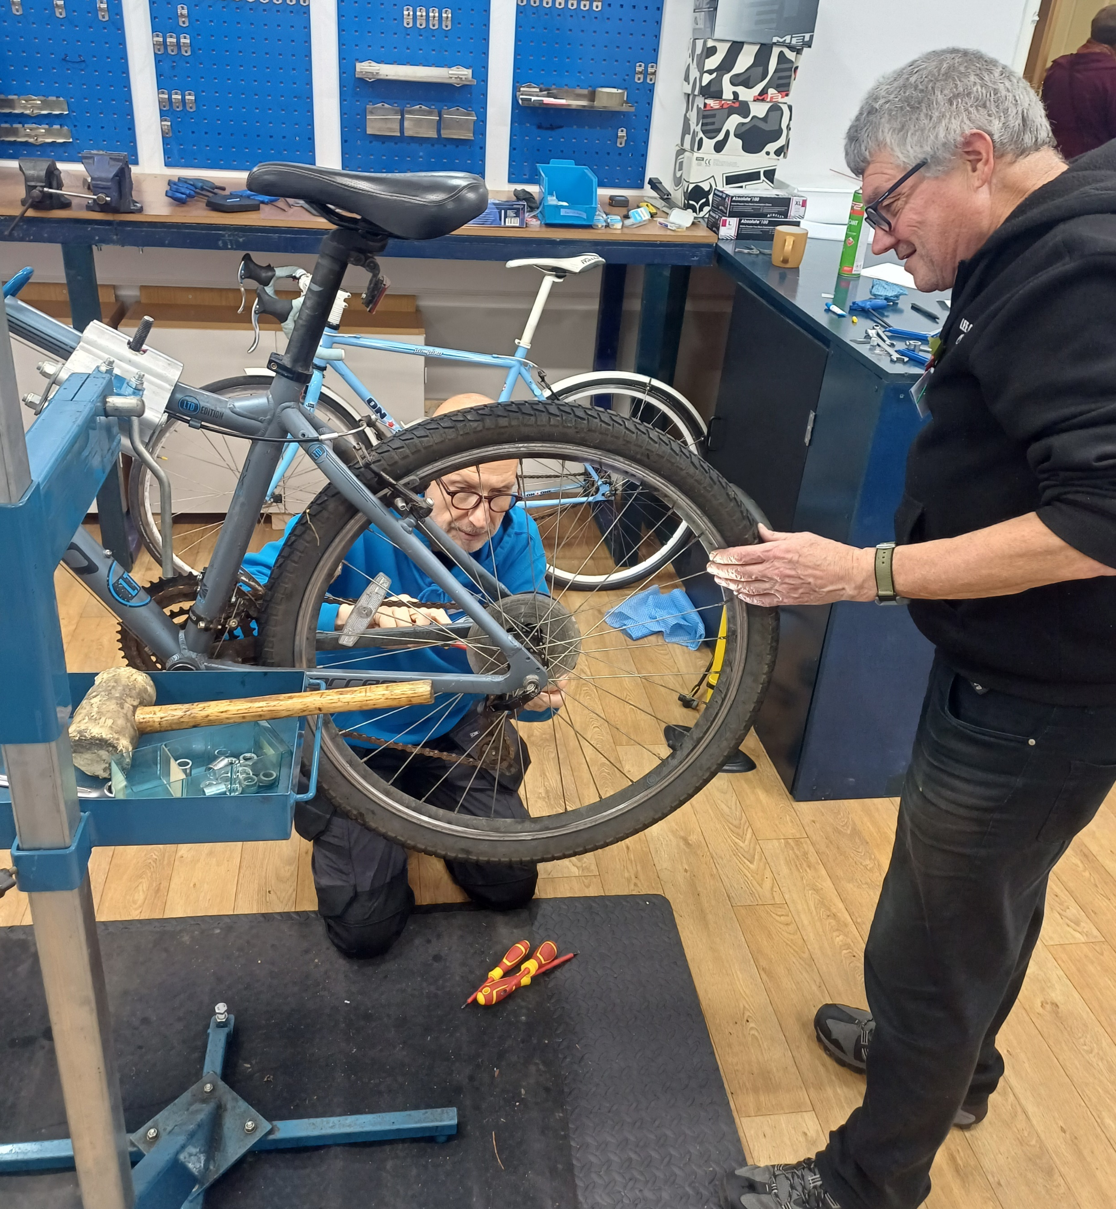
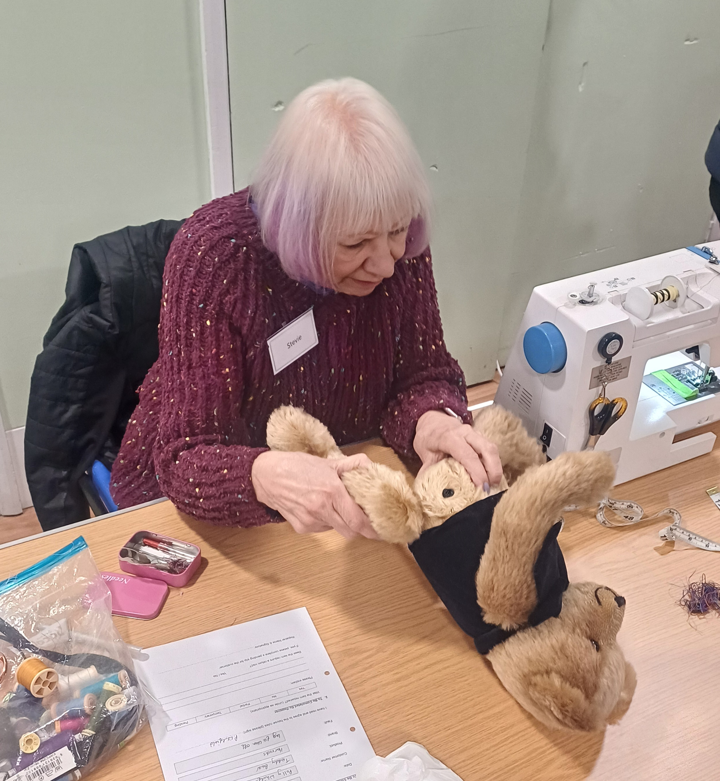
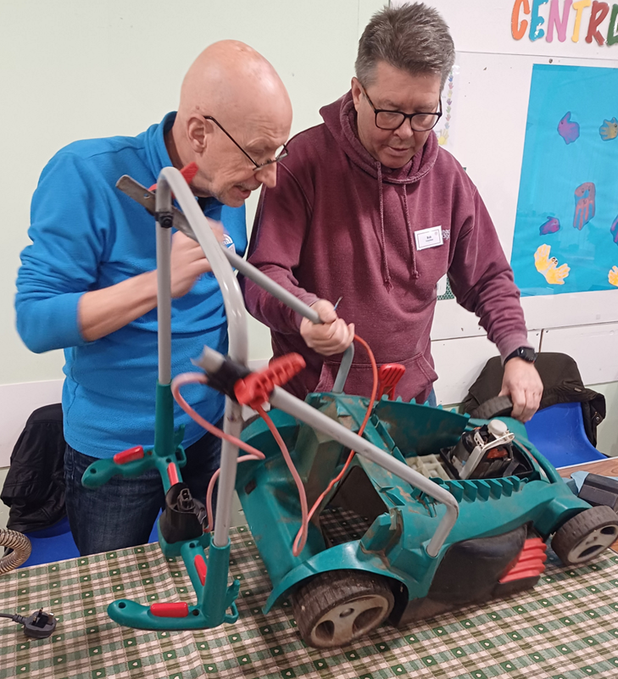
What do we repair?
Textiles / clothing
Soft toys
Bikes
Electronics
Small kitchen appliances
Toys
Tools / garden equipment
Furniture
Ornaments
Bags
etc etc etc………

Slide 6
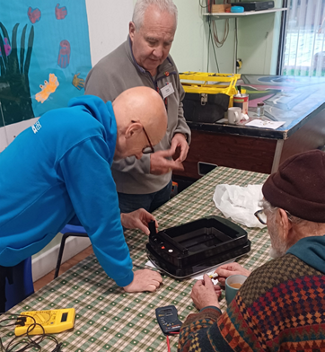
Who’s Involved?
5 organisers
28 volunteers signed up
(usually 14 – 18 attend each session)
3 volunteer roles
Repairers
Reception & Registration
Café

Slide 7
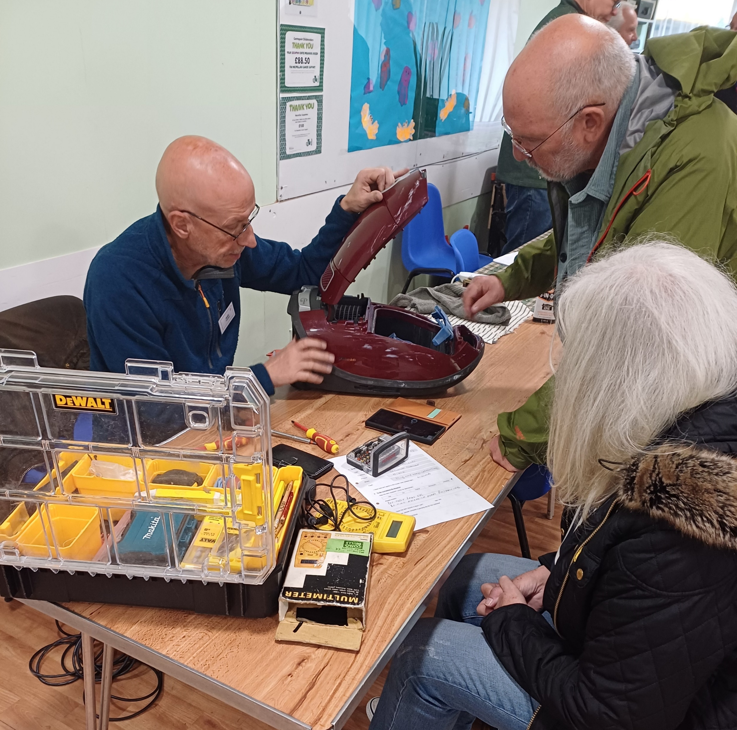
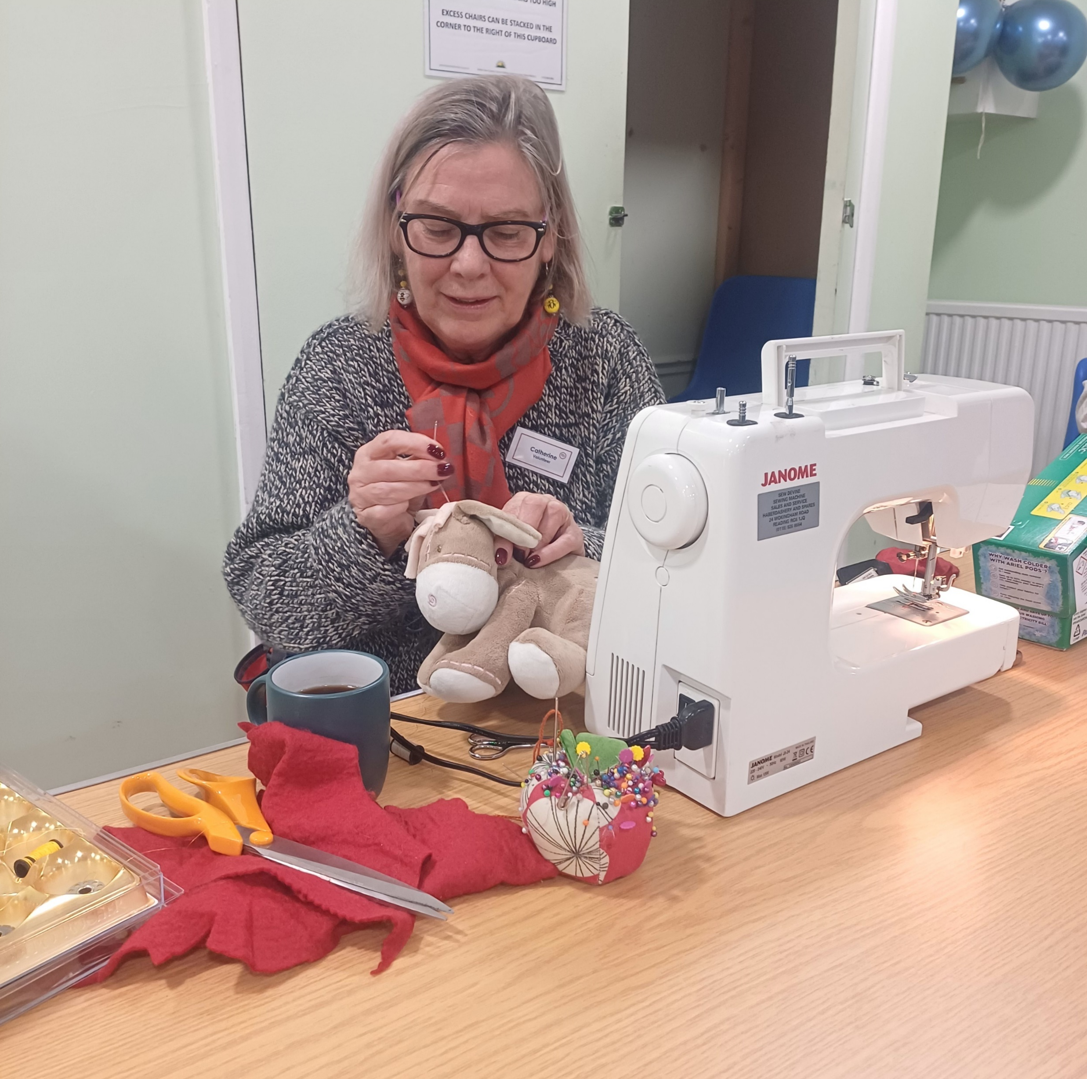
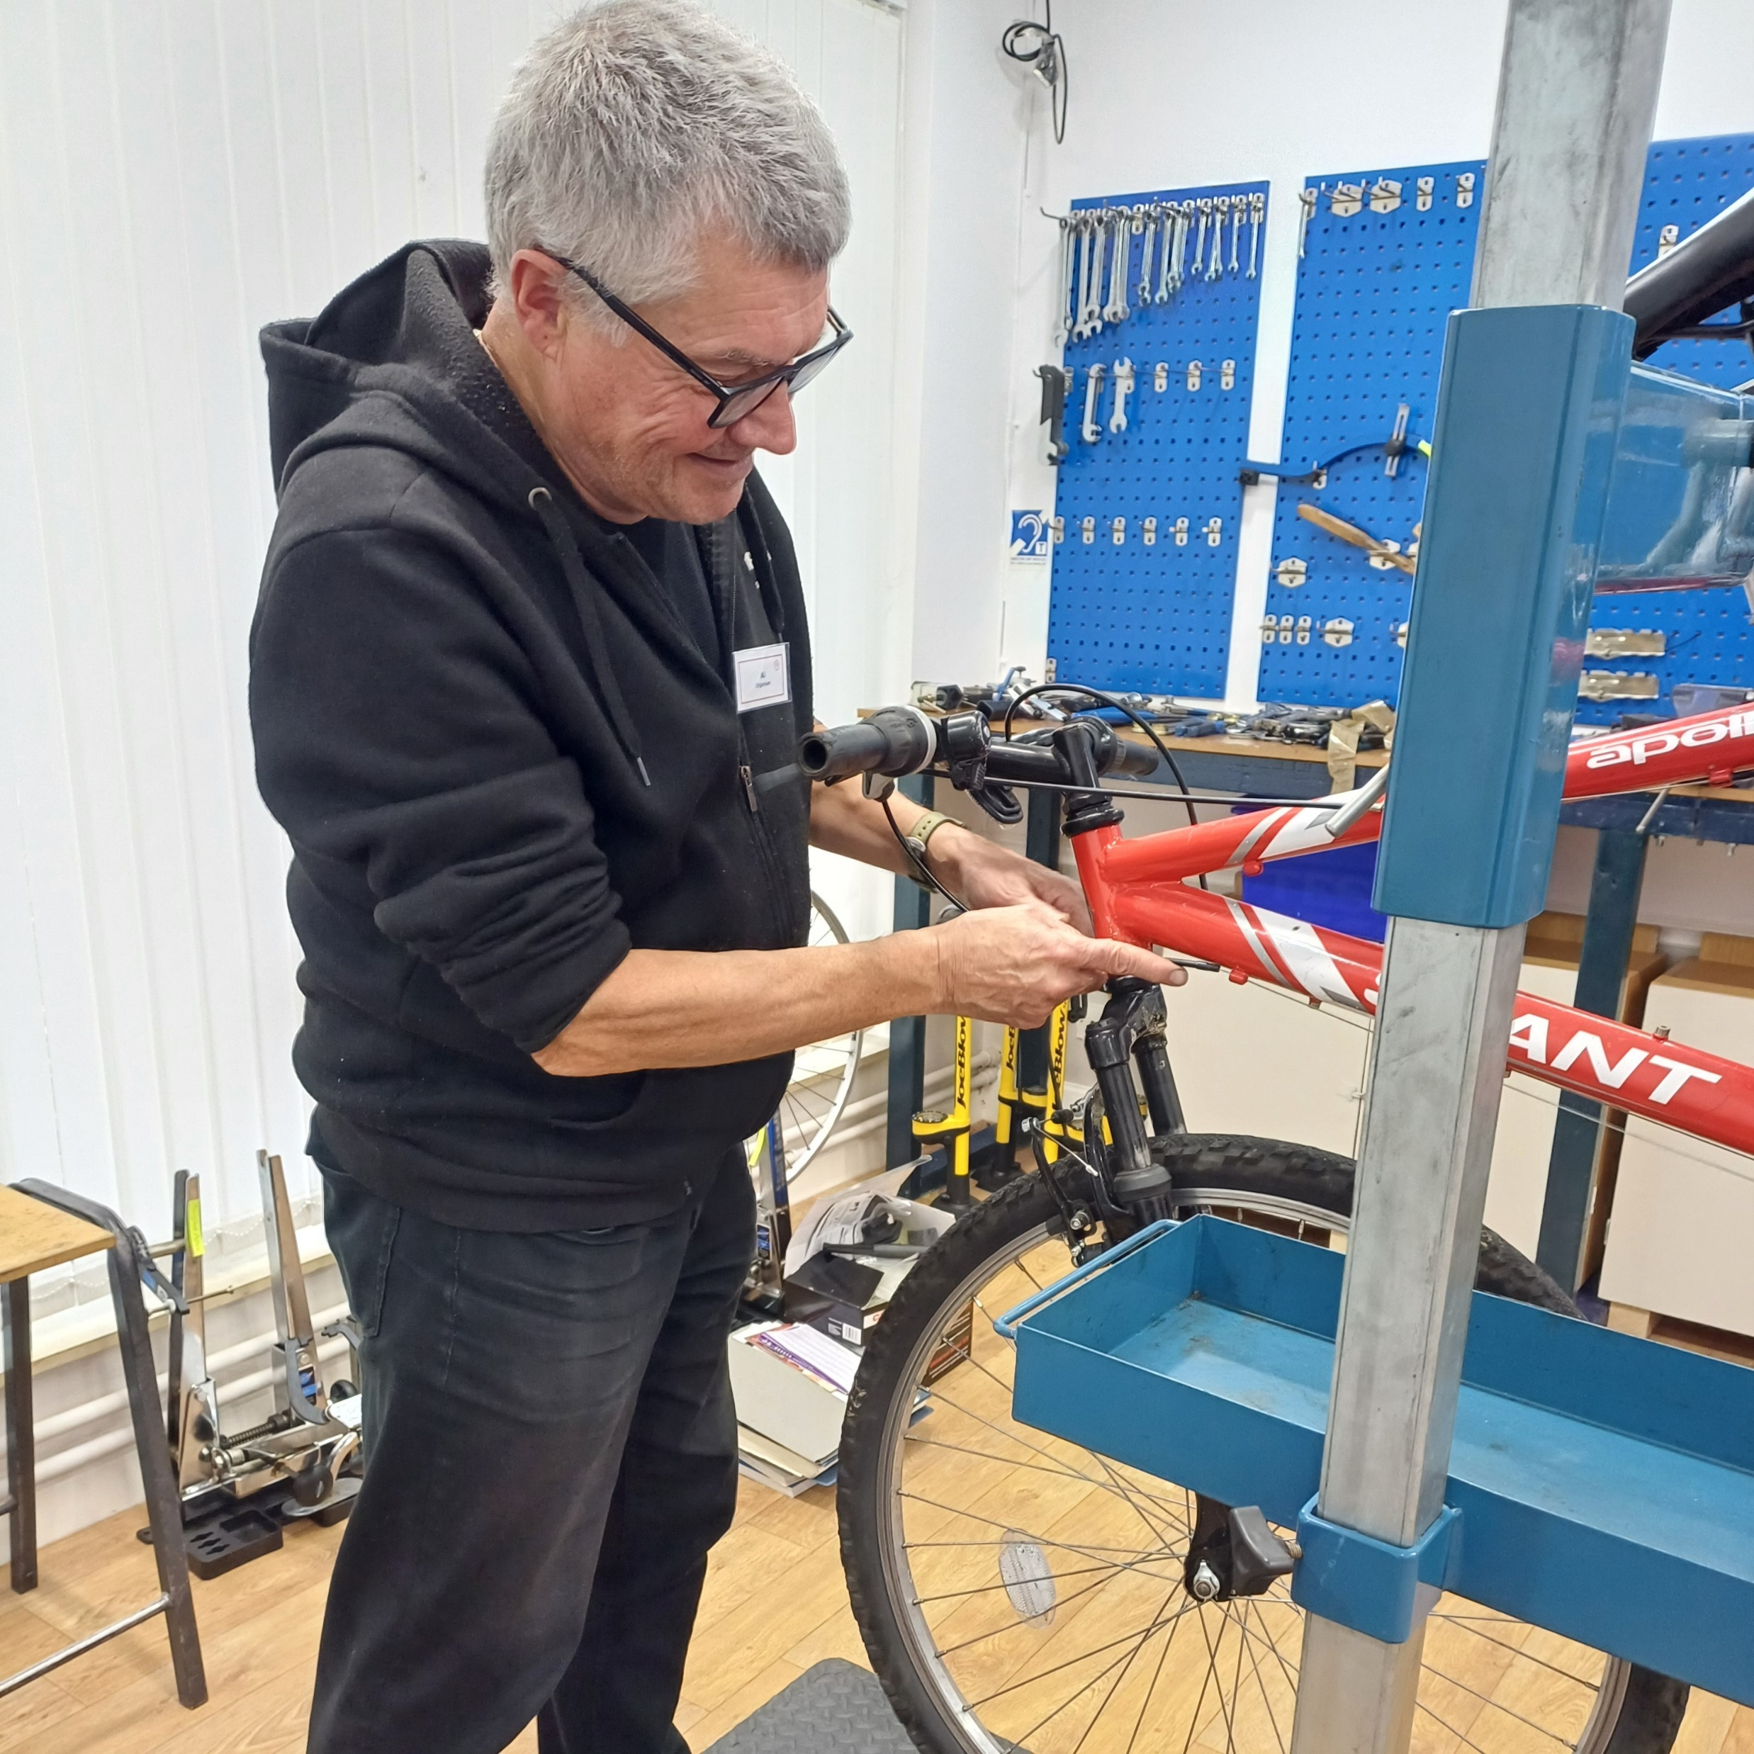
At the first session:
19 volunteers attended
47 items were registered
21 of these were fully repaired (plus 6 pending/partial repairs)

Slide 8
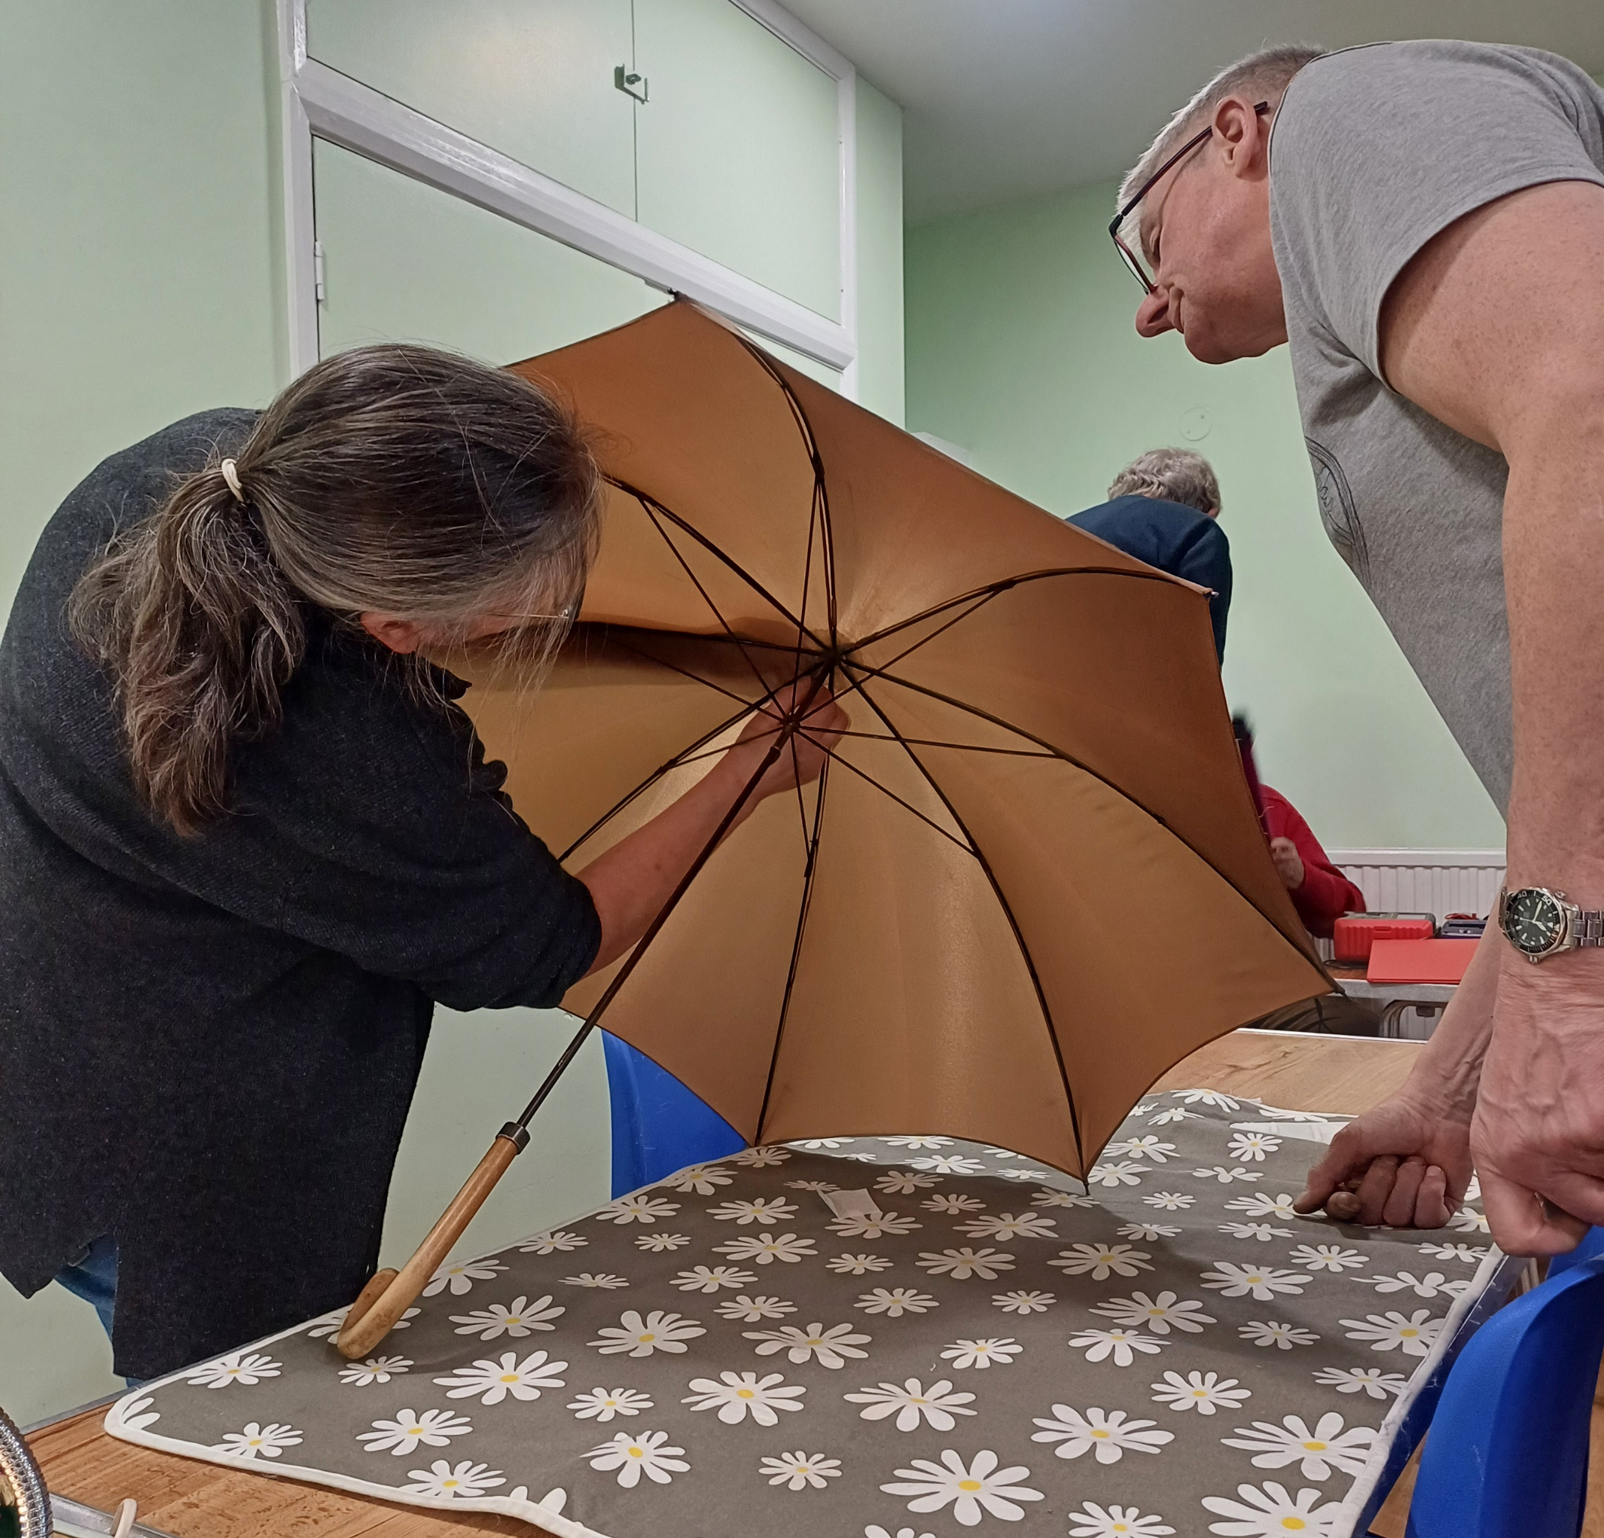
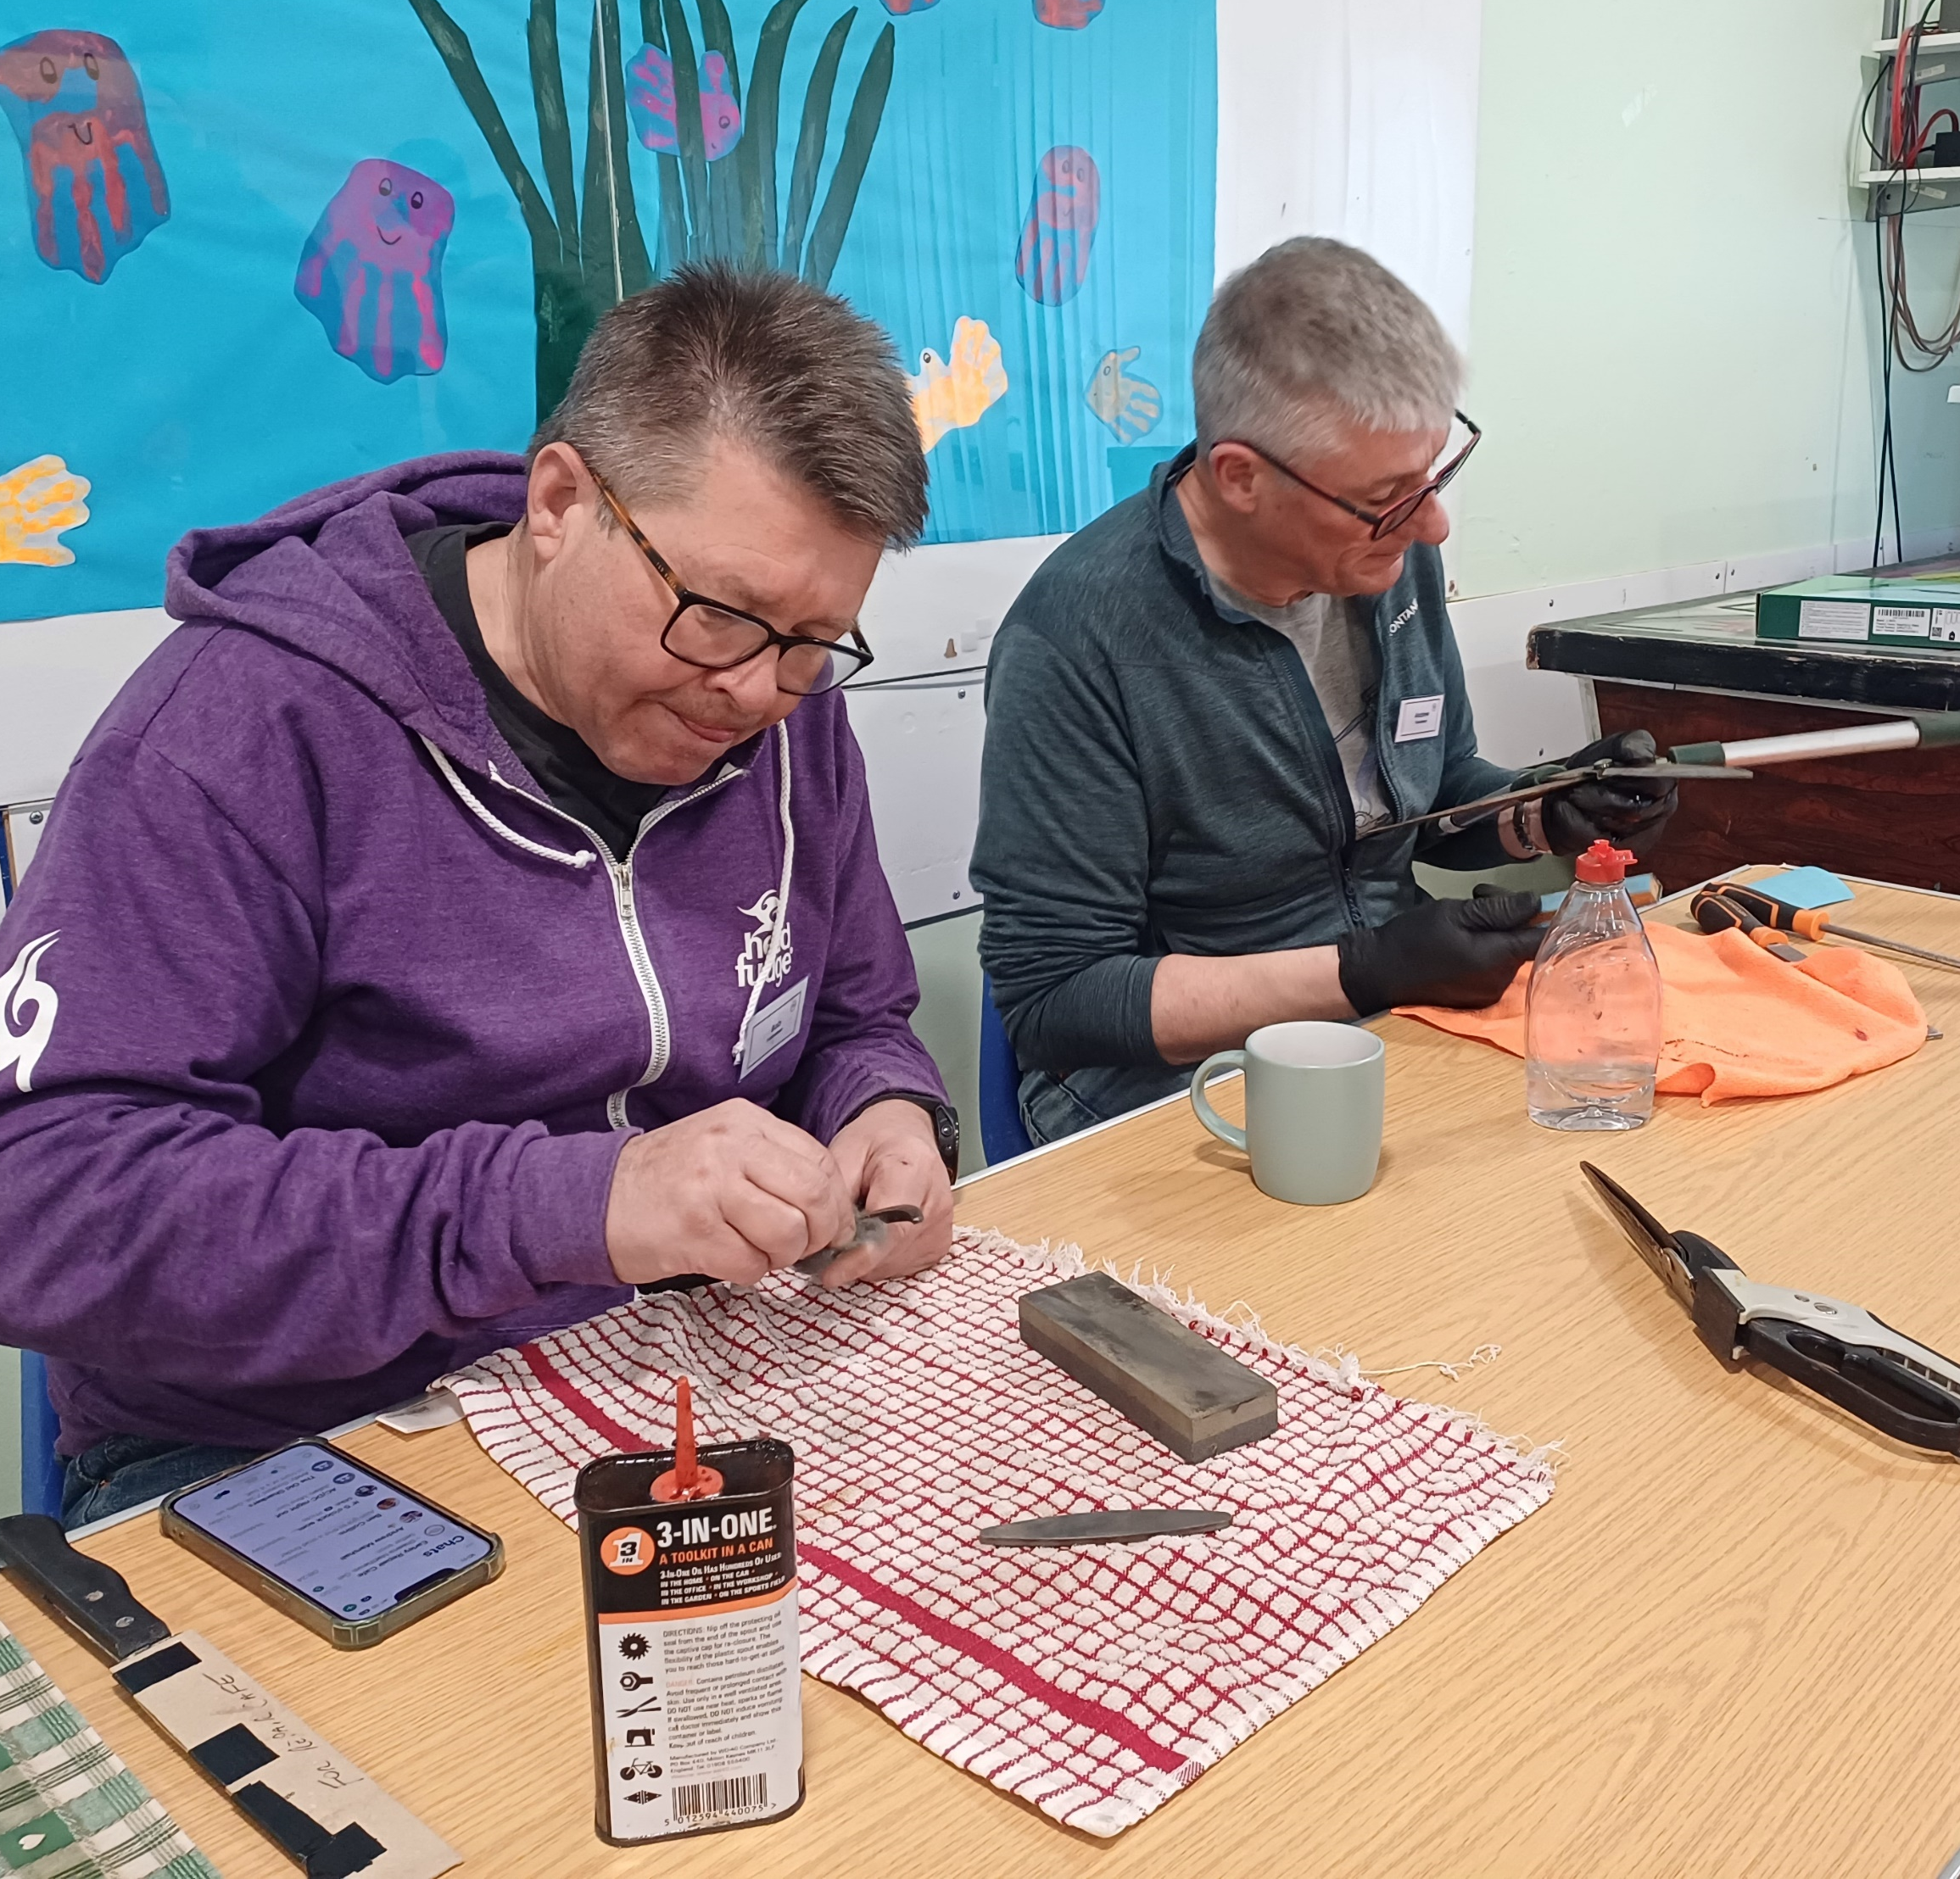
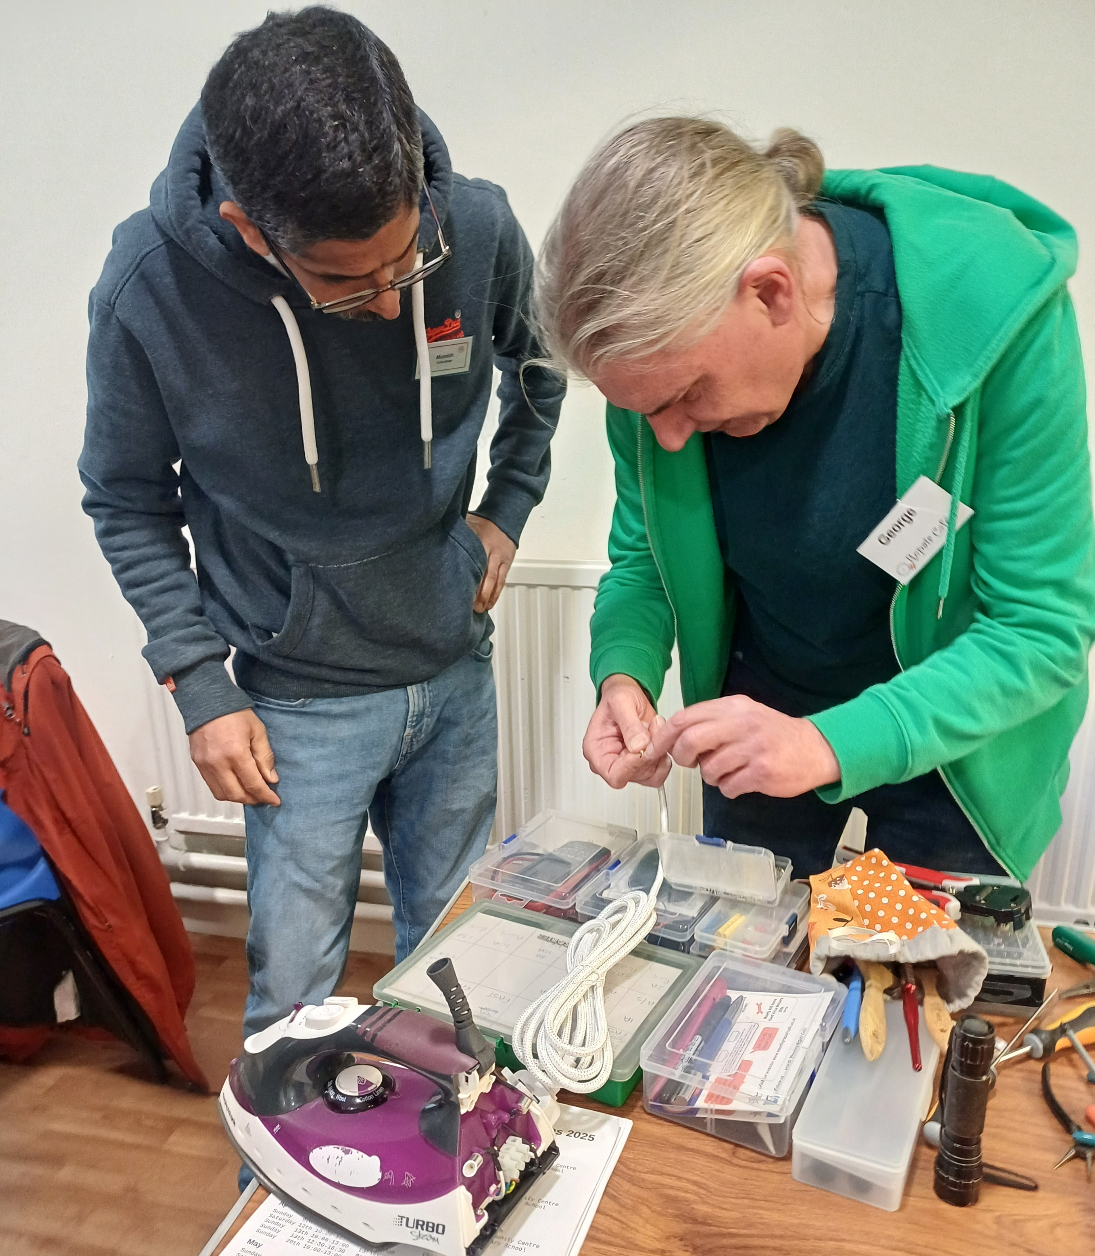
Stats so far…
243 items registered
53% fully repaired
15% partially repaired or pending
That’s 165 items saved!

Slide 9
Any Questions?
www.earley-tc.gov.uk/earley-repair-cafe

