Slide 1
Your Local Rotary Club
Pat Holloway
Reading Maiden Erlegh

Slide 2
What is Rotary?
Rotary is one of the world’s leading membership and humanitarian service organisations, with 1.4 million members globally.
Members of Rotary volunteer their time to make a difference in their local communities and around the world through projects which support education, fight disease, promote peace, provide clean water and much more.
Reading Maiden Erlegh

Slide 3
What is Rotary?
Reading Maiden Erlegh

Slide 4
A year in donations 2024
Reading Maiden Erlegh

Slide 5
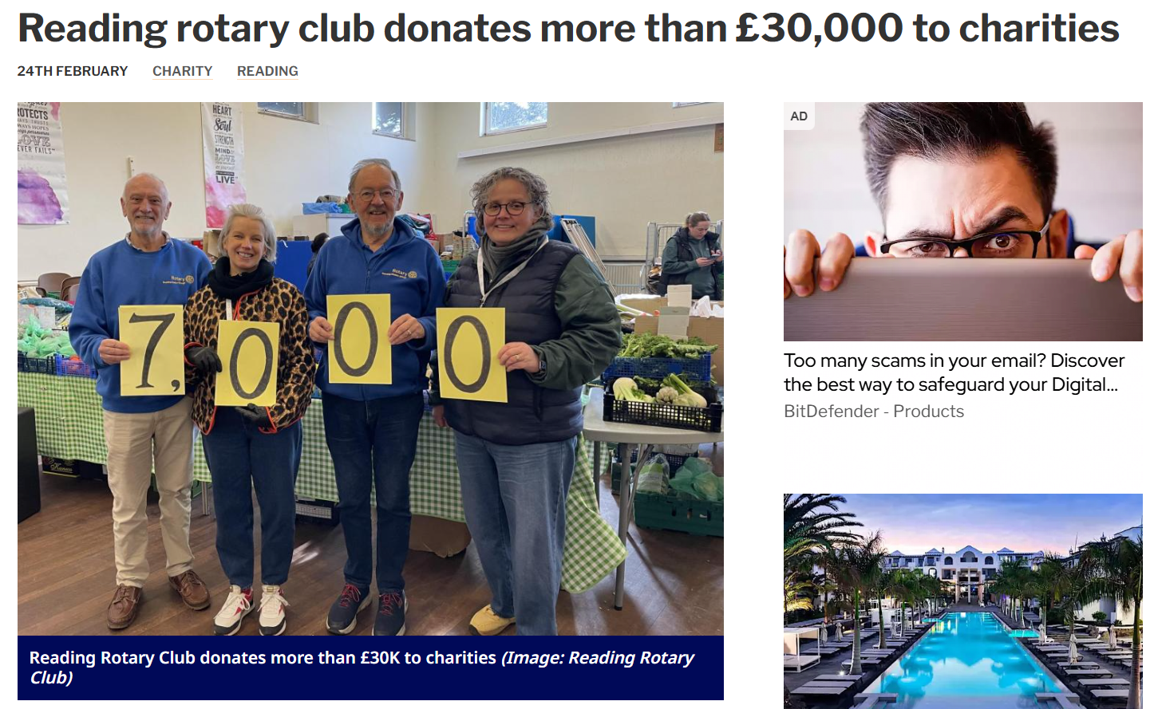
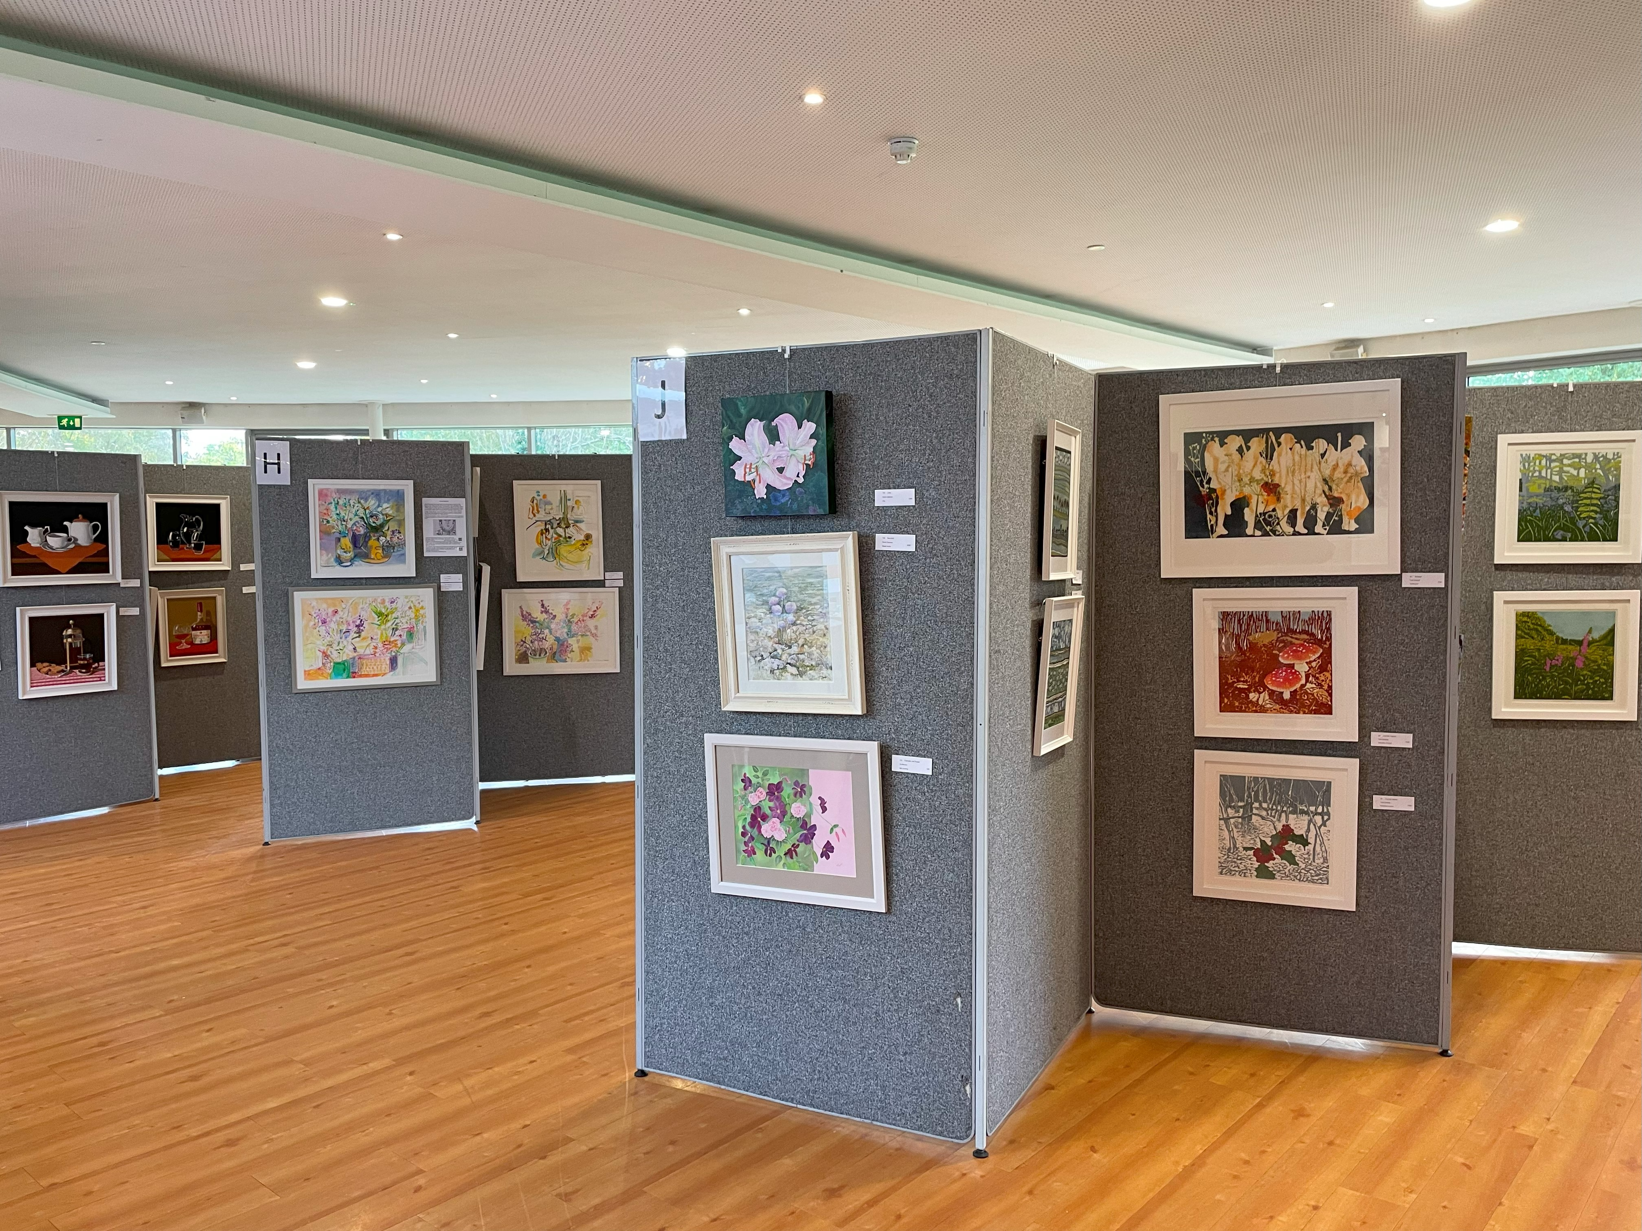
Our Club in the News
"The public and our partners have continued to be very generous in their support and the very high amount donated has enabled us to help a large number of local initiatives and overseas aid programmes.
"We are very grateful to everyone who has provided support.
"100 per cent of all the money collected goes to charity.“
Scott Trathen, joint president of RCRME.
Source: https://www.readingchronicle.co.uk/news/24947751.reading-rotary-club-donates-30-000-charities/
Reading Maiden Erlegh

Slide 6
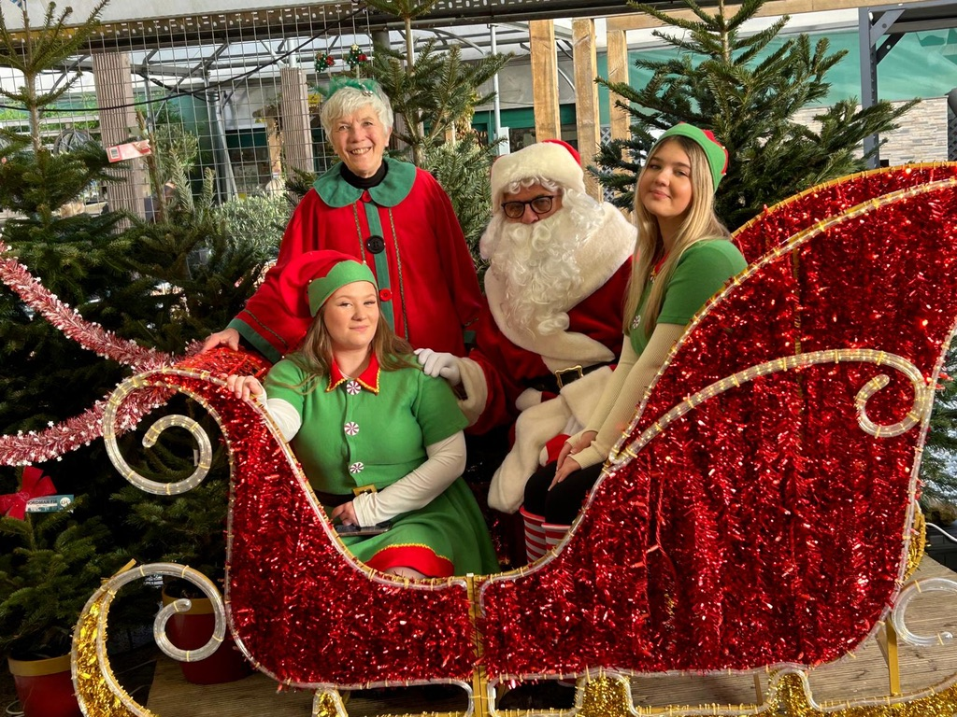
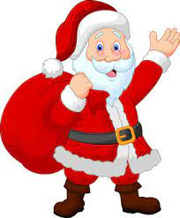
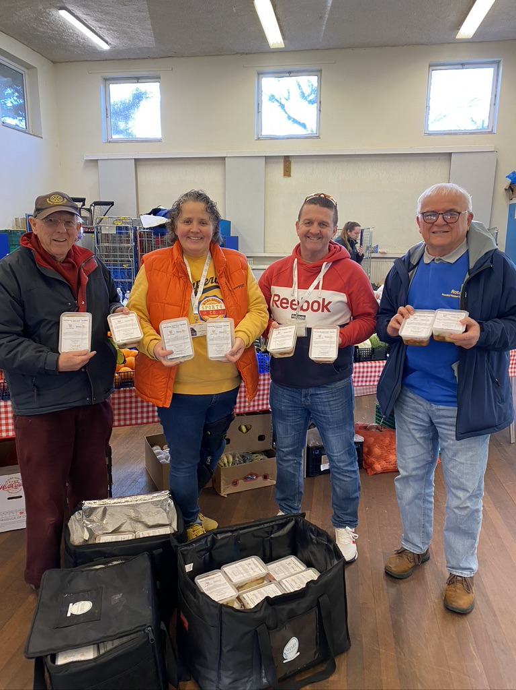
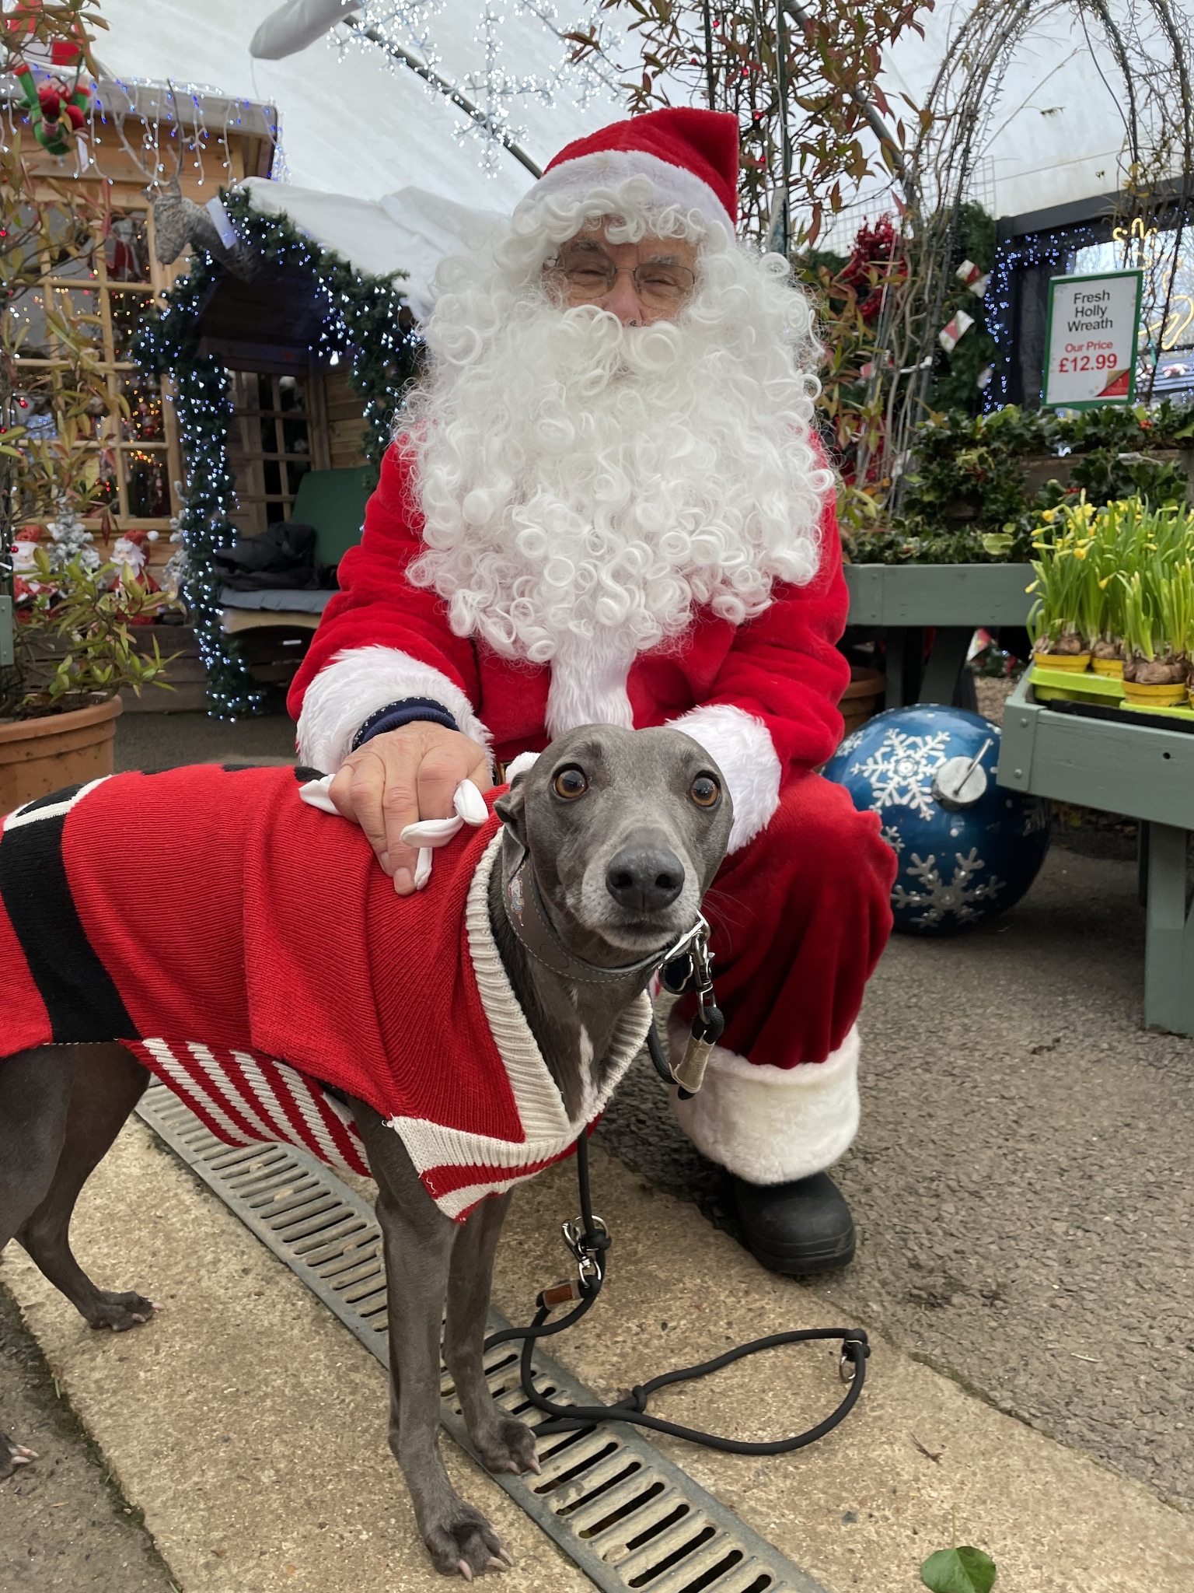
Reading Maiden Erlegh

Slide 7
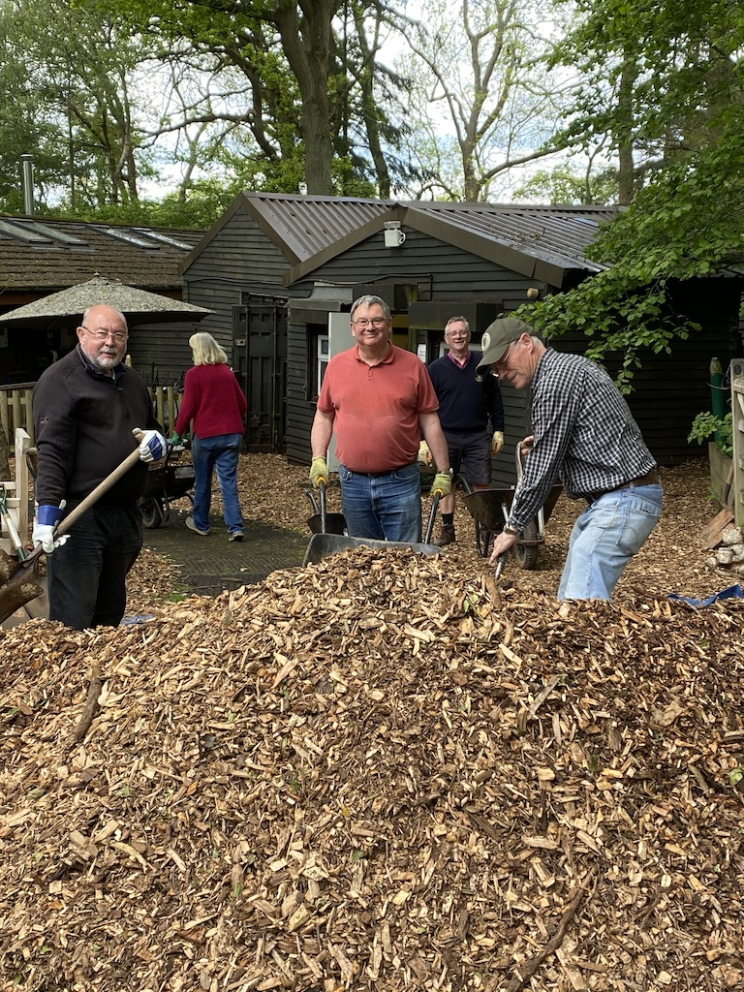
Helping Others Covid Vaccinations Camp Mohawk
Reading Maiden Erlegh

Slide 8
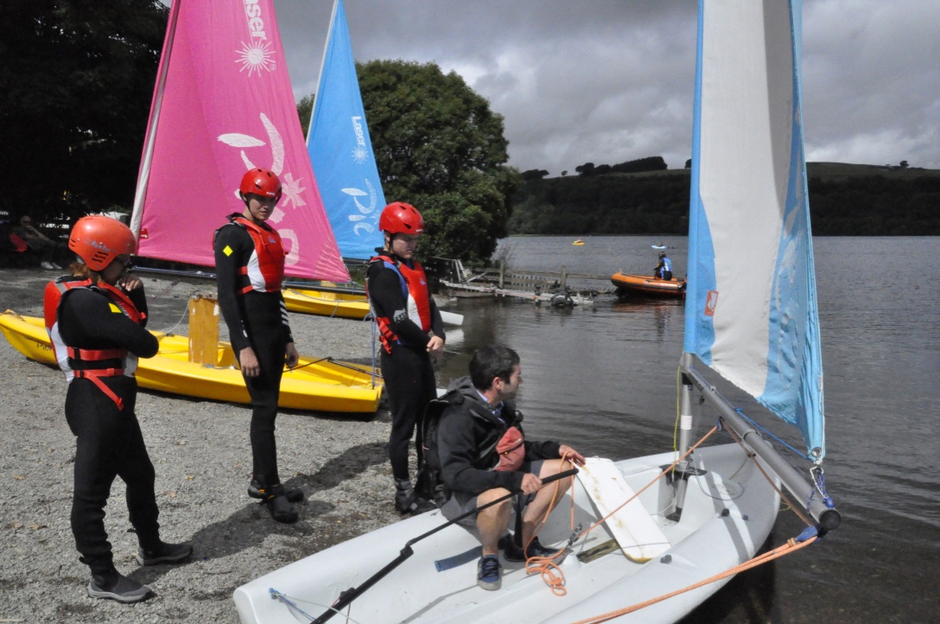
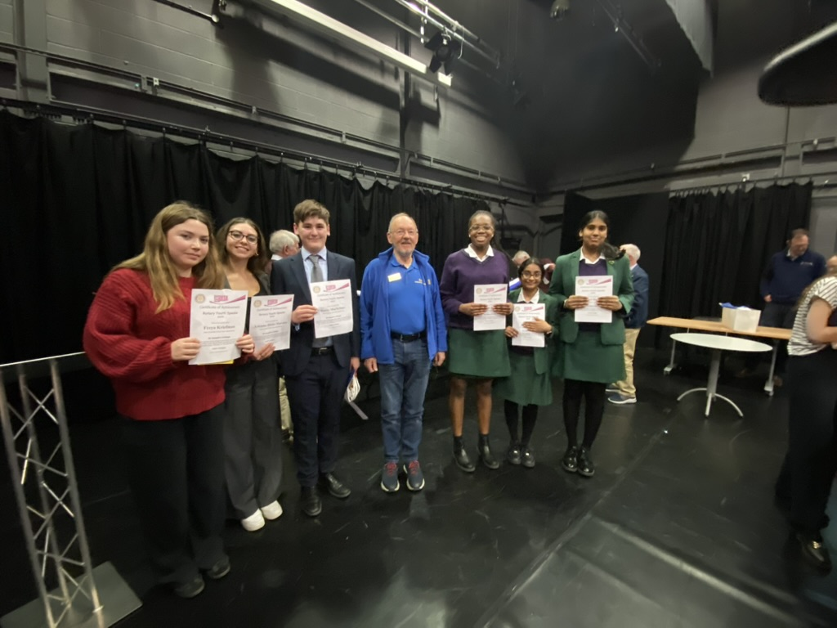
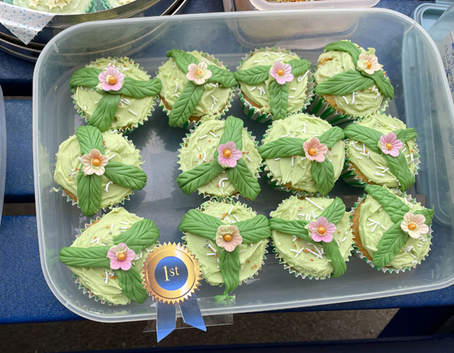
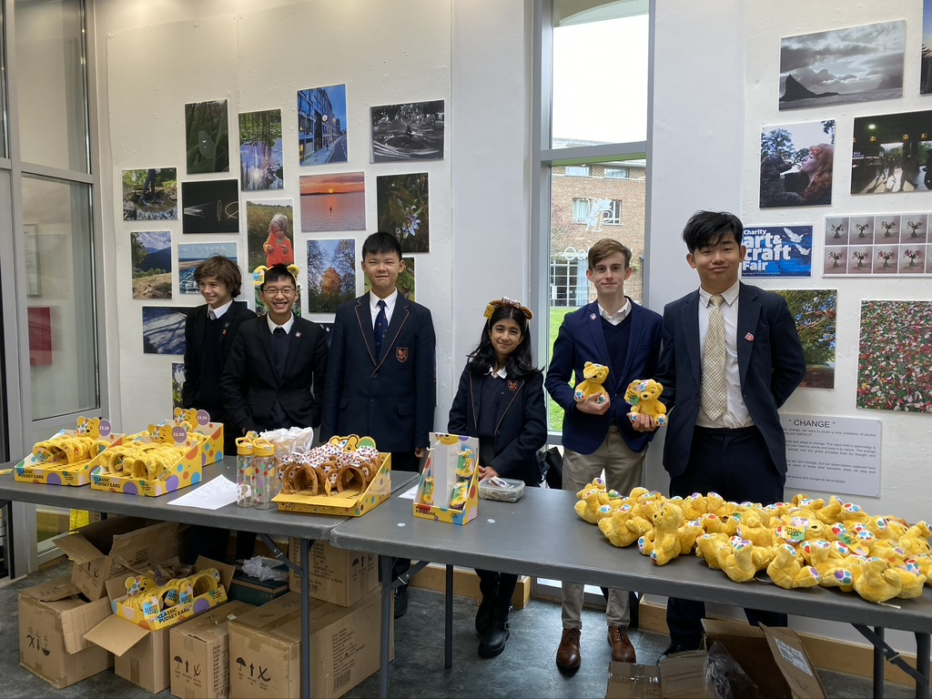
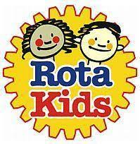
Rotary Youth Activities
Reading Maiden Erlegh

Slide 9
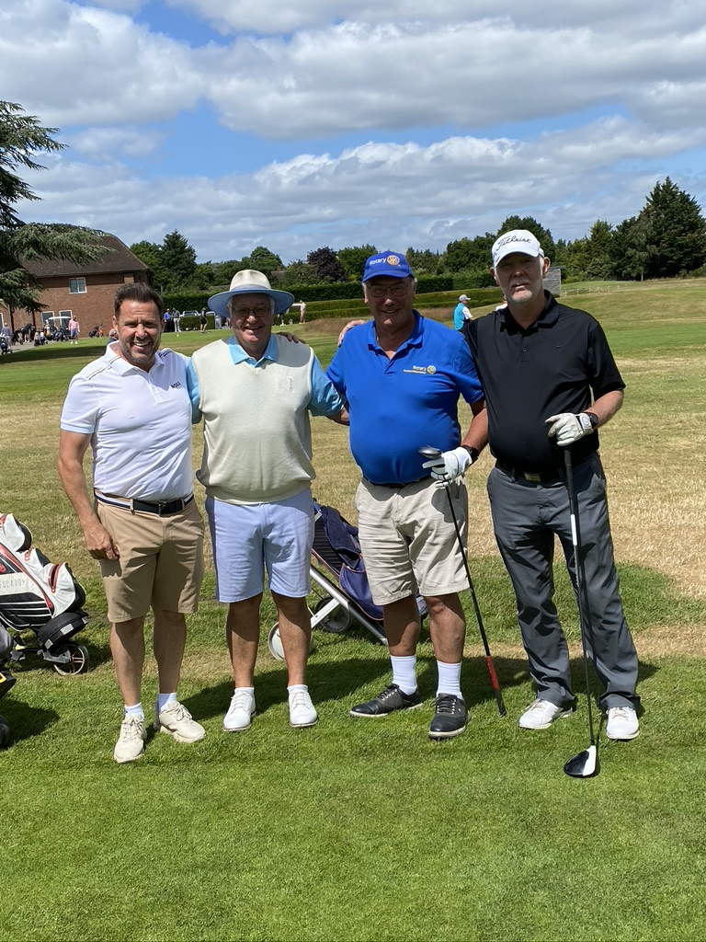
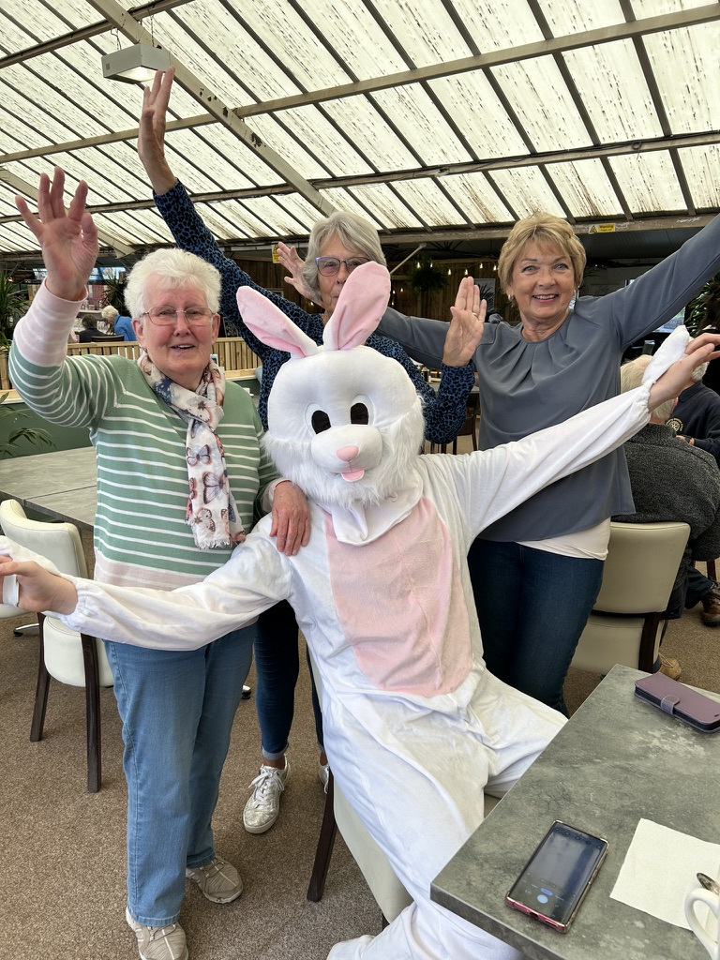
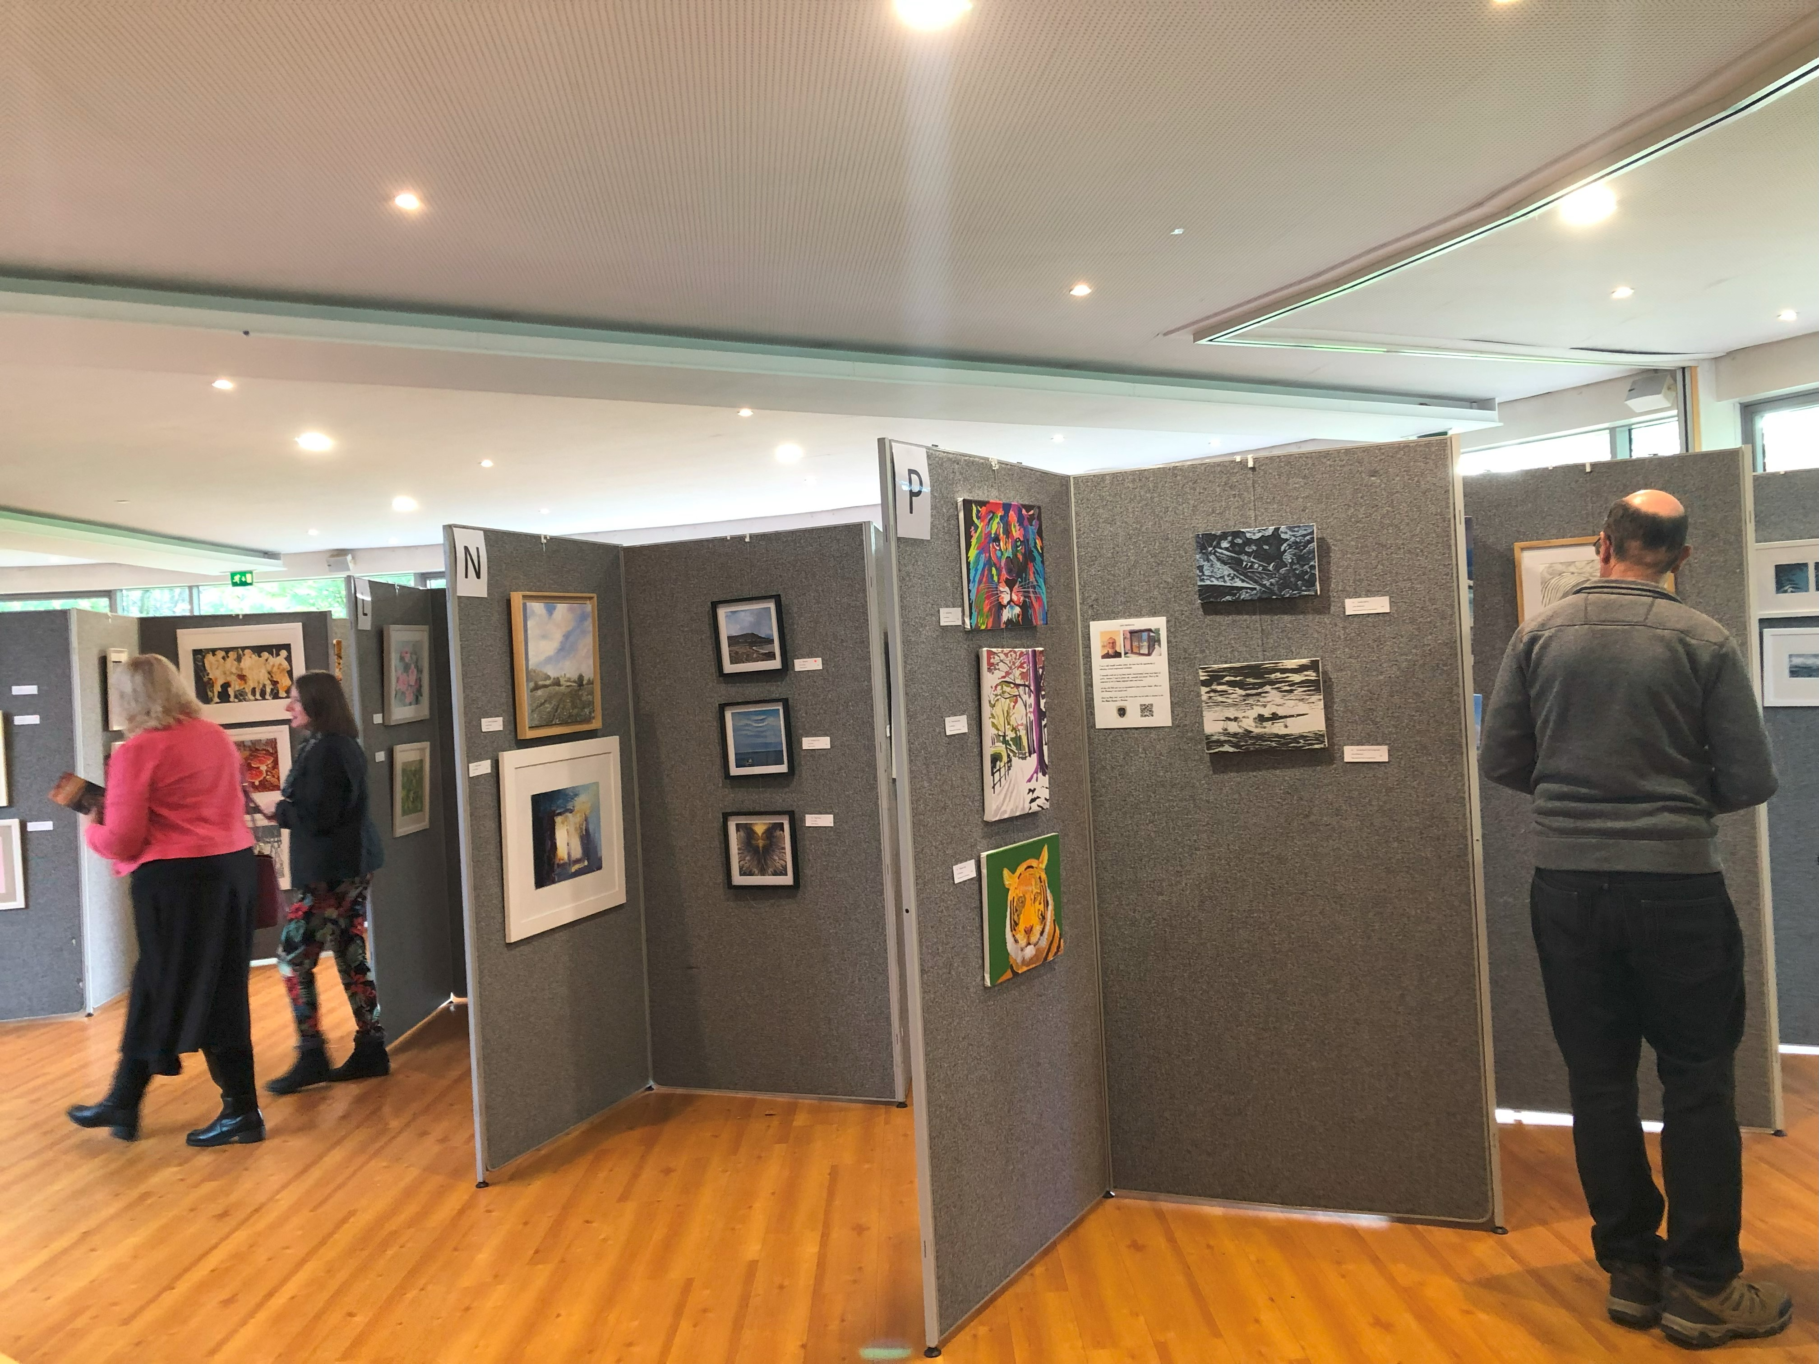
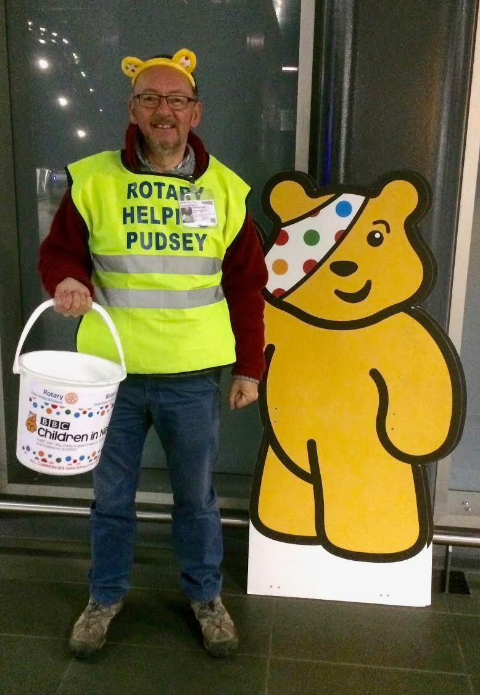
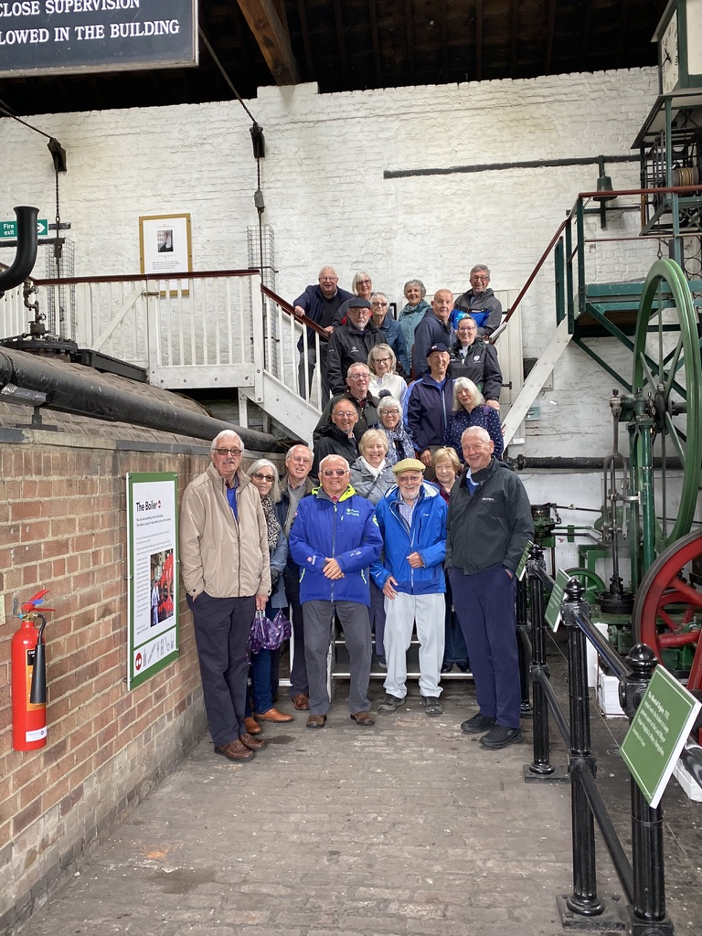
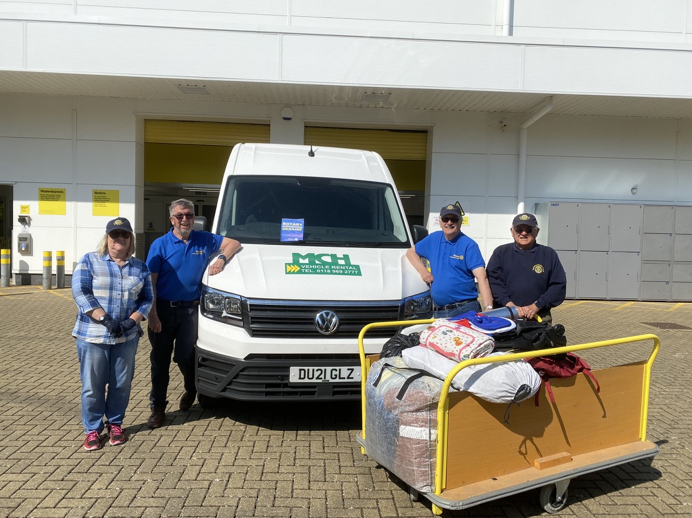
Get Involved
Support us
Volunteer with us
Fundraise with us
Socialise with us
Join us
Change lives with us
Reading Maiden Erlegh

Slide 10
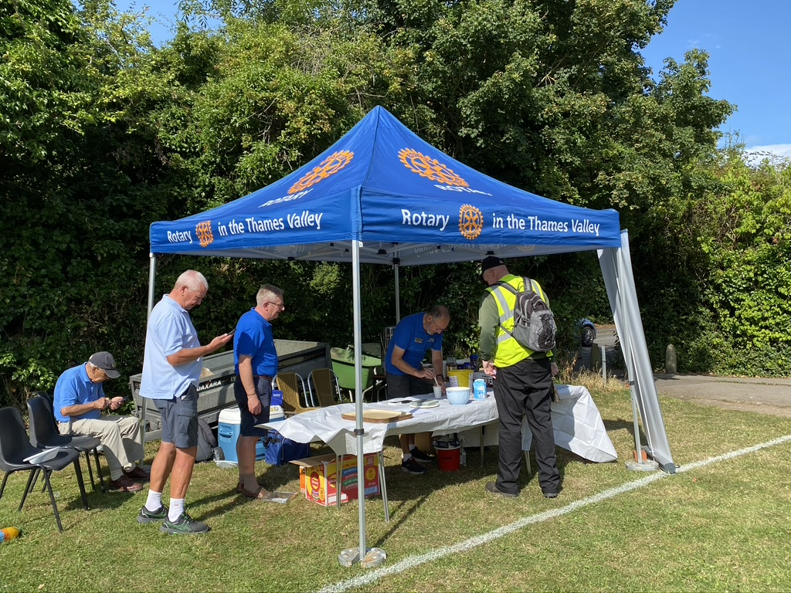
See Us in Action
Reading Community Festival at University of Reading Saturday 17th May
Early Town Green Fair 2nd August
Charity Art and Craft Fair Leighton Park School 24th Oct – 26th Oct
Reading Maiden Erlegh

