Slide 1
European Centre for Medium-Range Weather Forecasts Headquarters
Earley Town Council Meeting

Slide 2
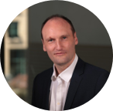
Introduction
John Gall CENG MICE - DSIT Project Director
~20 years working in civil engineering and project management
Currently work for Turner & Townsend within Department of Science, Innovation and Technology
Previously worked at Government Property Agency, CERN, Local Authorities and Jacobs Engineering Consultancy

Slide 3
Introduction
Who are ECMWF?
What is the project?
How are we delivering the works?
Why are we building a new HQ?
When will it be delivered?
Questions

Slide 4
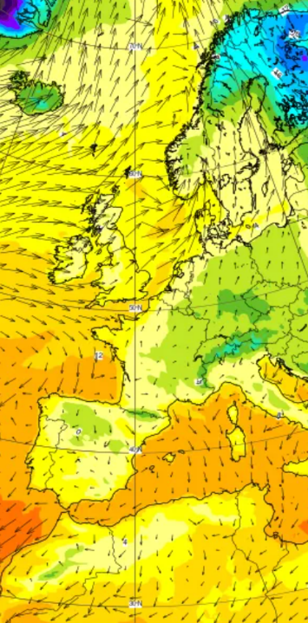
Who are ECMWF?
The European Centre for Medium-Range Weather Forecasts
Independent intergovernmental organisation with 23 Member States and 12 Co-operating States
HQ site has been based at Shinfield Park, Reading since 1970s
ECMWF's core mission is to:
produce numerical weather forecasts and monitor the Earth system
carry out scientific and technical research to improve forecast skill
maintain an archive of meteorological data
*Place image here
Notes:
Intergovernmental organisation of which the UK is a member state along with most nations of Europe.
They have been based in the same building on an ex-MoD site in Reading since the 70’s
And they aim to produce critical numerical weather forecasts, which is used by major European state and academic institutions, including the Met Office in the UK.
They also own and maintain the worlds largest archive of meteorological data.

Slide 5
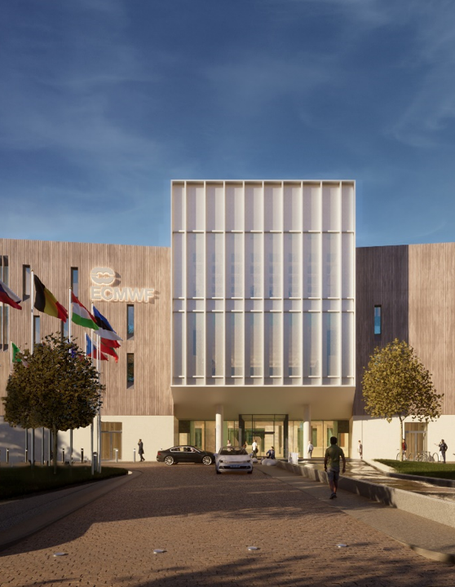
What is the Project?
Existing Shinfield Road HQ is no longer fit for purpose
ECMWF accepted a UK offer to continue as host nation - Dec 2021
New build HQ required on a brownfield site at University of Reading Whiteknights Campus close to Earley Gate
Notes:
So in terms of what we’re aiming to do for them:
Aim of the project is to build ECMWF a new HQ to replace the building they’ve been in since the 70’s and is no longer fit for purpose
The UK made an offer to ECMWF to continue as the host nation and which was accepted in 2021. As part of this, we’re building the new HQ on a brownfield site at the University of Reading’s WhiteKnights campus.
As part of the deal, the government will lease the land from UoR, construct the HQ, and then provide it to ECMWF for a period of 50 years. A which point we expect that the building will no longer be fit for purpose.
The net present value of the project sits at £100.7 Million, which is mainlu driven by inward foreign investment to ECMWF. This gives it a benefit cost ratio of just under 2. Demonstrating good value for the taxpayers money that we’ll be spending.

Slide 6
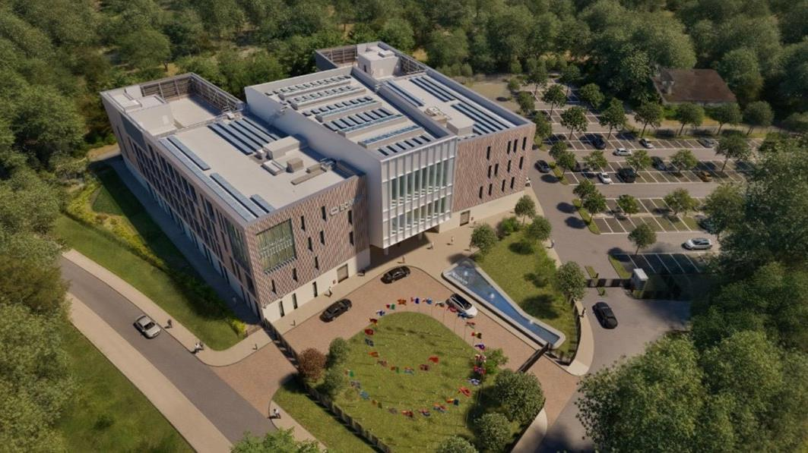

Slide 7
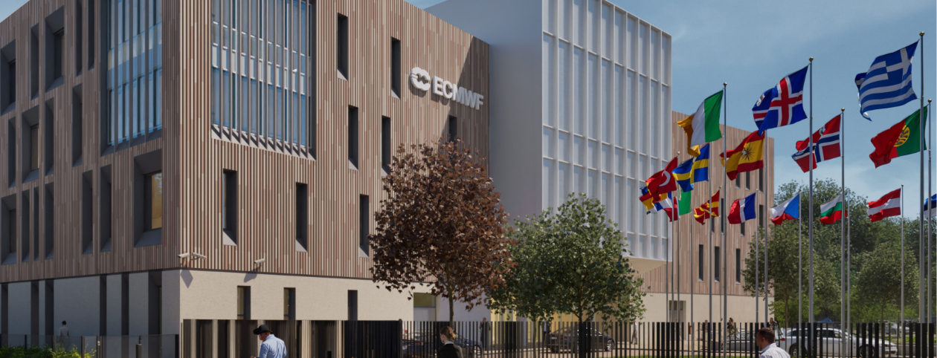
Visuals

Slide 8
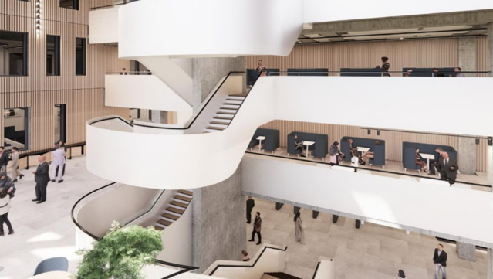
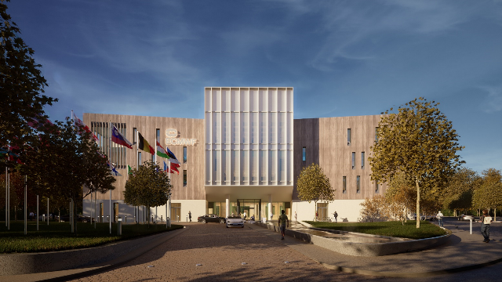
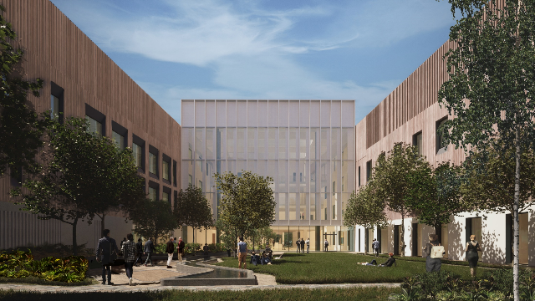
Notes:
Clockwise from top left
- The building will have a large atrium space with a feature stair case
- we’ve then got another shot directly of the front of the building and the main entrance
- followed by the council chamber which the feature staircase leads up to
- finally we’ve got a view of the back of the building, which will feature and enclosed garden for recreational use for ECMWF staff

Slide 9
Project Scope
HQ for ~300 Staff
Lecture Theatre & Council Chamber
Restaurant
Net Zero
Up to 50-year Lease
Notes:
Scope of the project;
- HQ will accommodate 300 staff
- It will be built to the highest Net-Zero standards, paying particular attention to embodied and operational carbon
- The building will include features such as a council chamber and lecture theatre as well as a fully operational restaurant to allow it to host international delegations as required by intergovernmental organisations
So that’s what we’re aiming to achieve, but what does it achieve for the government and to for the taxpayer?
The economic benefits centre on retaining around 300 highly skilled jobs in the UK, and also Retaining associated investment from other European Governments into the UK
- The agglomeration benefits are critical to this project, hosting EMWF at the UoR will create the worlds largest hub of climate scientists, along with representation from Met Office and National Centre for Atmospheric Science among others
- Key to maintaining the UK’s reputation as a world leader in climate science
- By hosting ECMWF at the UoR campus, we also intend to see greater science collaboration and training opportunities for UK PhD students and researchers
- Just on the point about this being a net-zero building, we intend to see some really strong Learning and reputational benefits for UK Gov as a result of creating a pioneering carbon-neutral building

Slide 10
How are we delivering the Project?
Client
UK Government Funder and Sponsor
UK Government Delivery Lead
Project Management, Cost Consultant, Technical Advisor
Design and Build Contractor
Lead Designer and Architect

Slide 11
Why are we delivering the Project?
Retain Jobs
Retain Investment
World’s largest cluster of climate science
Training Opportunities
Science Collaboration
UK Reputation as leader in climate science
Notes:
Scope of the project;
- HQ will accommodate 300 staff
- It will be built to the highest Net-Zero standards, paying particular attention to embodied and operational carbon
- The building will include features such as a council chamber and lecture theatre as well as a fully operational restaurant to allow it to host international delegations as required by intergovernmental organisations
So that’s what we’re aiming to achieve, but what does it achieve for the government and to for the taxpayer?
The economic benefits centre on retaining around 300 highly skilled jobs in the UK, and also Retaining associated investment from other European Governments into the UK
- The agglomeration benefits are critical to this project, hosting EMWF at the UoR will create the worlds largest hub of climate scientists, along with representation from Met Office and National Centre for Atmospheric Science among others
- Key to maintaining the UK’s reputation as a world leader in climate science
- By hosting ECMWF at the UoR campus, we also intend to see greater science collaboration and training opportunities for UK PhD students and researchers
- Just on the point about this being a net-zero building, we intend to see some really strong Learning and reputational benefits for UK Gov as a result of creating a pioneering carbon-neutral building

Slide 12
When will it be delivered?
Notes:
Scope of the project;
- HQ will accommodate 300 staff
- It will be built to the highest Net-Zero standards, paying particular attention to embodied and operational carbon
- The building will include features such as a council chamber and lecture theatre as well as a fully operational restaurant to allow it to host international delegations as required by intergovernmental organisations
So that’s what we’re aiming to achieve, but what does it achieve for the government and to for the taxpayer?
The economic benefits centre on retaining around 300 highly skilled jobs in the UK, and also Retaining associated investment from other European Governments into the UK
- The agglomeration benefits are critical to this project, hosting EMWF at the UoR will create the worlds largest hub of climate scientists, along with representation from Met Office and National Centre for Atmospheric Science among others
- Key to maintaining the UK’s reputation as a world leader in climate science
- By hosting ECMWF at the UoR campus, we also intend to see greater science collaboration and training opportunities for UK PhD students and researchers
- Just on the point about this being a net-zero building, we intend to see some really strong Learning and reputational benefits for UK Gov as a result of creating a pioneering carbon-neutral building

Slide 13
Thank YOu for listening
Any Questions?

Slide 15
