Slide 1
Age UK Berkshire
Lesley Hoey
Services Manager
Lesley.hoey@ageukberkshire.org.uk
info@ageukberkshire.org.uk
Tel 0118 959 4242

Slide 2
Age UK Berkshire
The Charity
Services Offered
Questions

Slide 3
Age UK Berkshire
First registered as Age Concern Berkshire in April 1964
Part of the formal partnership with Age UK
An independent, locally-managed and locally-funded charity, able to respond to and provide for the needs of people in later life across Berkshire
Cover the entire county and work in partnership with Age UK Reading and Age Concerns in Windsor, Bracknell and Newbury and other local charities including Understanding Dementia, Volunteers centre, The Link Visiting and Involve.

Slide 4
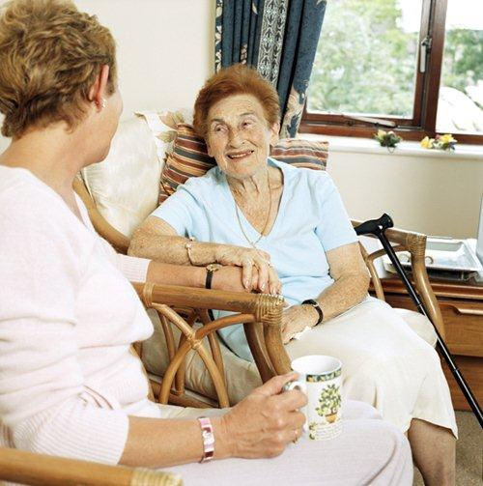
Age UK Berkshire Services
Information and advice - for anyone over the age of 50, friends/ family members- help to access relevant services, care, health, advocacy, legal and financial services. We can do personal benefit checks and advise on energy and utility savings. (not legal or professional financial advice).
Support for people with dementia and their carers- activities, walks, MCST, dementia friendly work.
Handyperson- For small jobs around the home e.g. putting up grab rails, curtain rails, windows or door locks

Slide 5
Age UK Berkshire Services
Keeping in Touch project- weekly calls and visits to prevent crisis
Lead for Dementia Friendly Wokingham
Partner in the Friendship Alliance
Partner in the Hardship Alliance

Slide 6
Home From Hospital
Service designed to support individuals for 2-3 weeks post hospital discharge
Offer practical support- picking up medication, shopping, light cleaning, laundry
Offers emotional/ social support- sit down and have a cup of tea, benefit check, information and advice
With permission can keep family updated on progress
Liaison with ASC and GP if needed
Other forms of support and referrals.

Slide 7
Thank you for listening
Any Questions?
info@ageukberkshire.org.uk
0118 959 4242
www.ageukberkshire.org.uk

